Slide 1
THG Simulations
Project update
Week 3
09/08/2023
David Amorim

Slide 2
Outline
Saturation
Effect of beam power
Effect of ionisation
Effect of CEO phase
Spectral peaks
Beam shape
Self-steepening

Slide 3
Saturation was achieved!!!
Show spectra!!! -> show sample run again ??
Analyse breaking points in detail!
Compare to measured data!
USE MORE NEON PLOTS????!!!

Slide 4
I. SATURATION

Slide 5
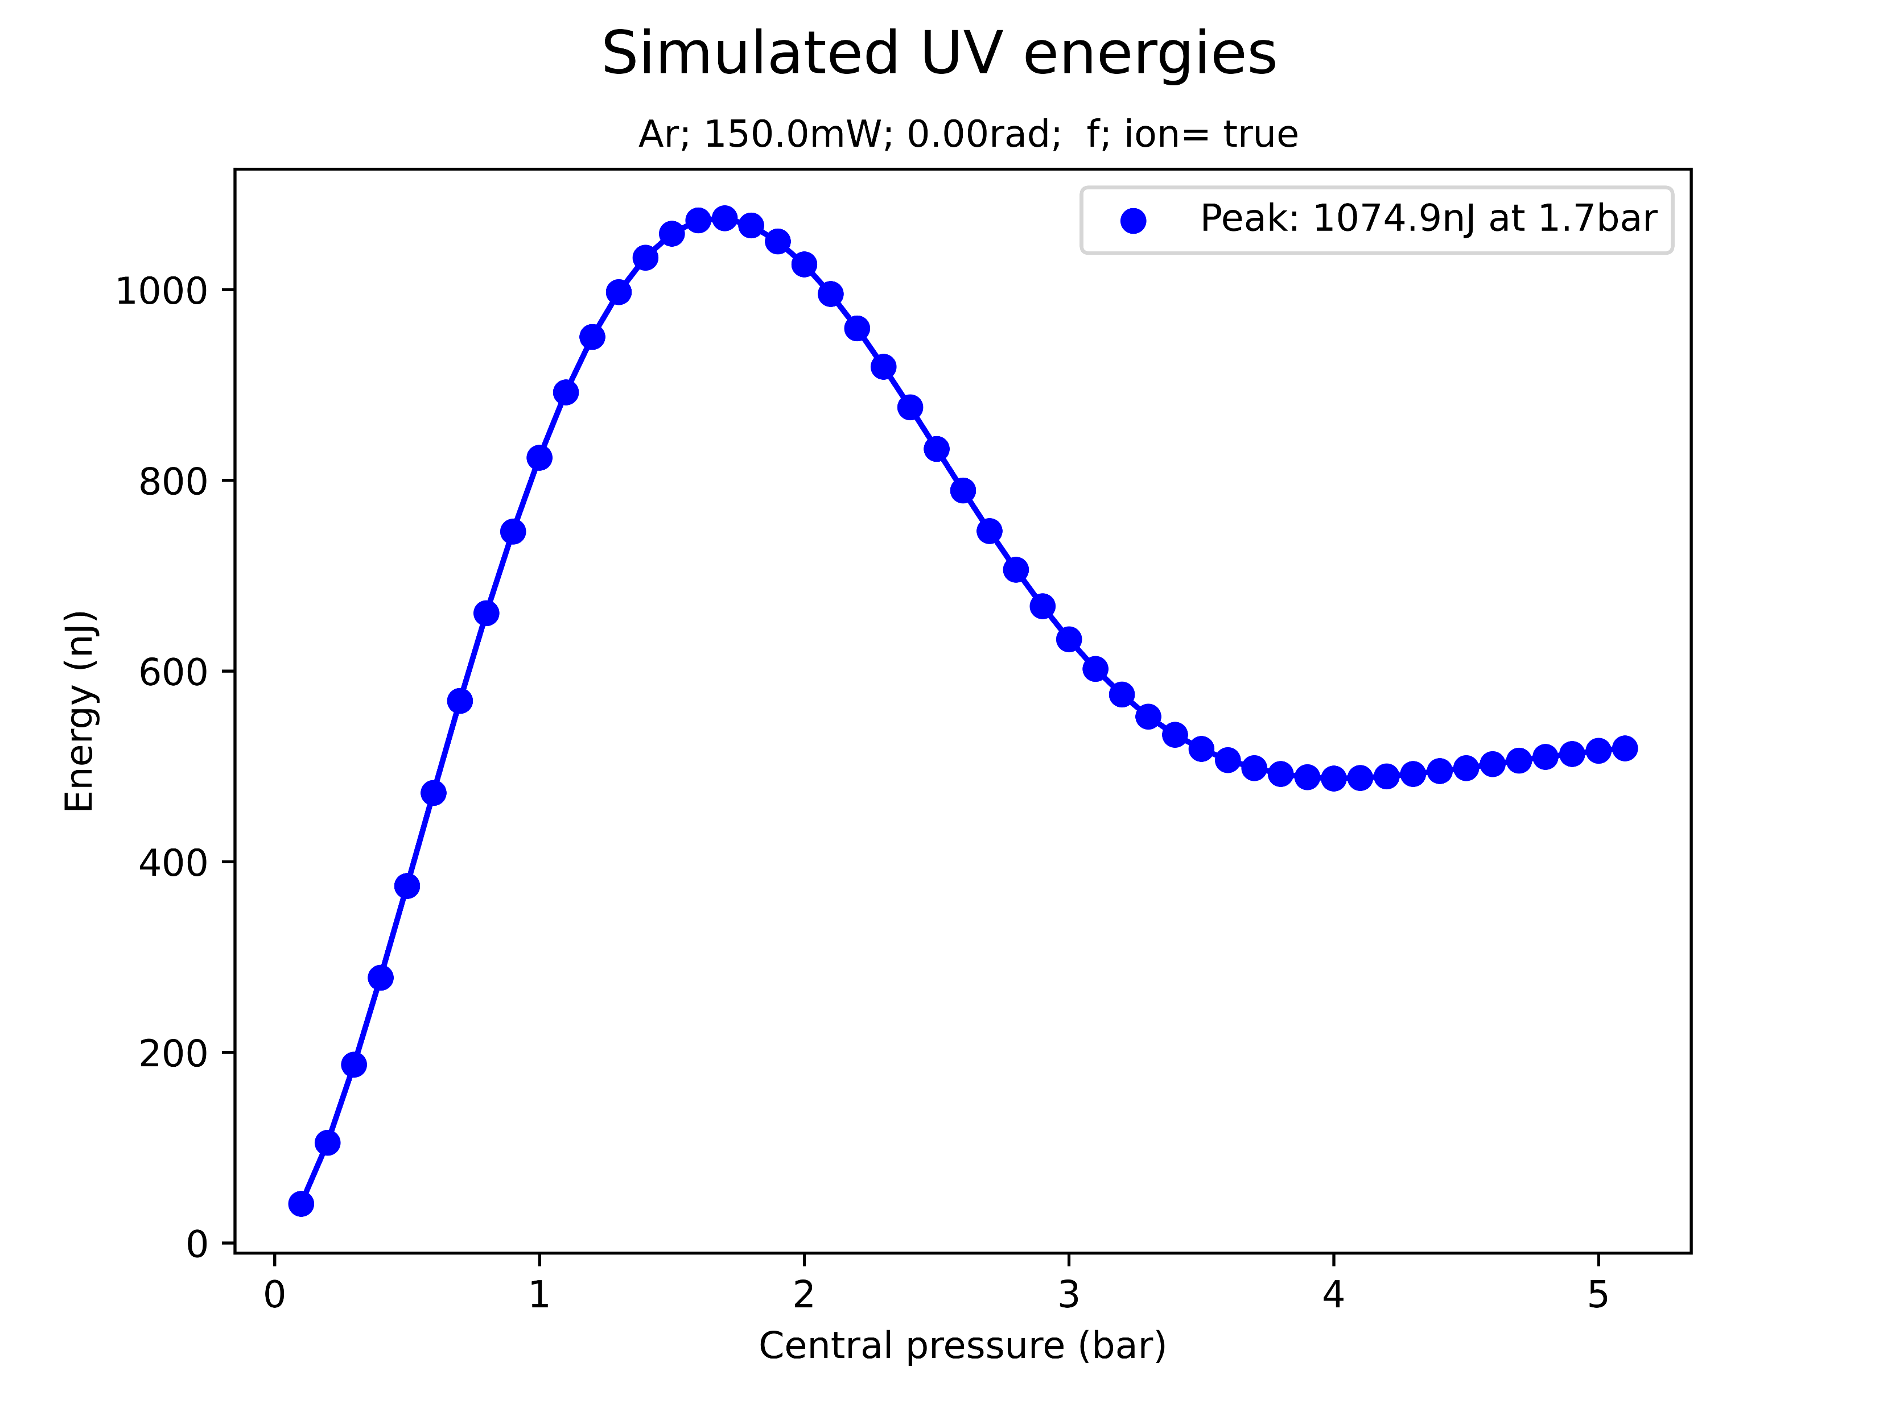
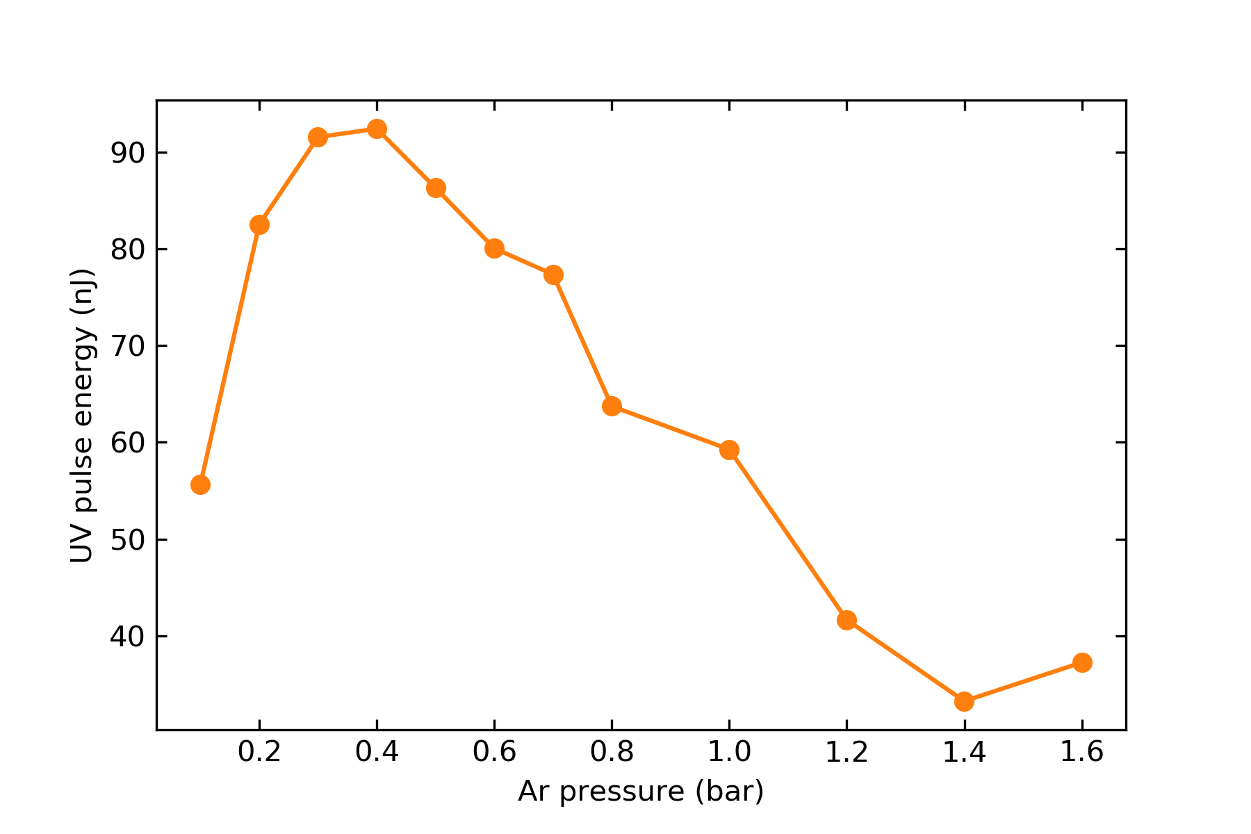
Saturation
simulated
At sufficiently high pressures, the simulation predicts a saturation in the UV energy
Qualitatively, this agrees with experiments
However, simulated saturation energies and pressures are much higher!
measured (same params)

Slide 6
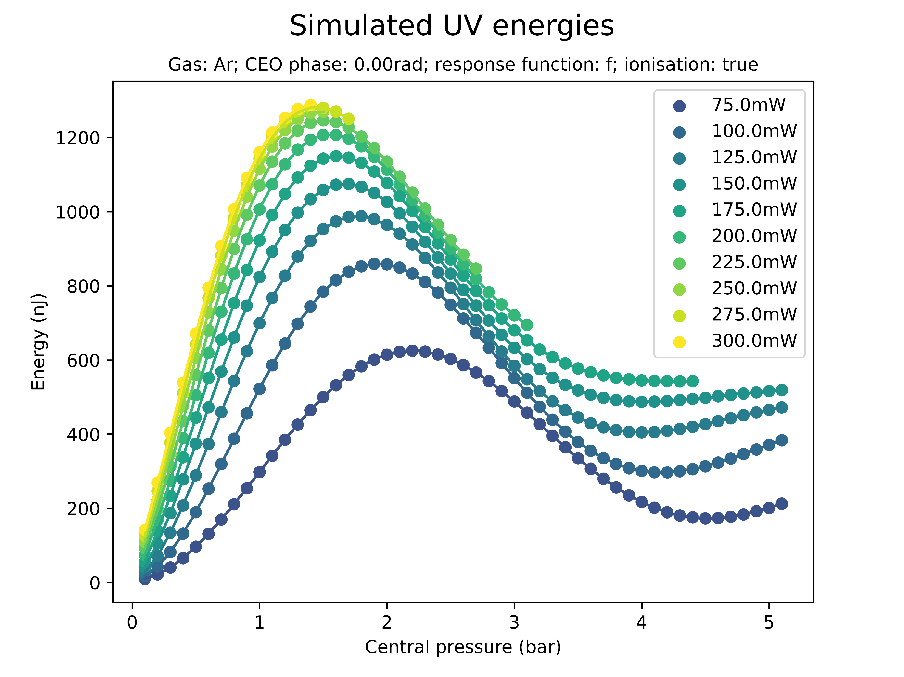
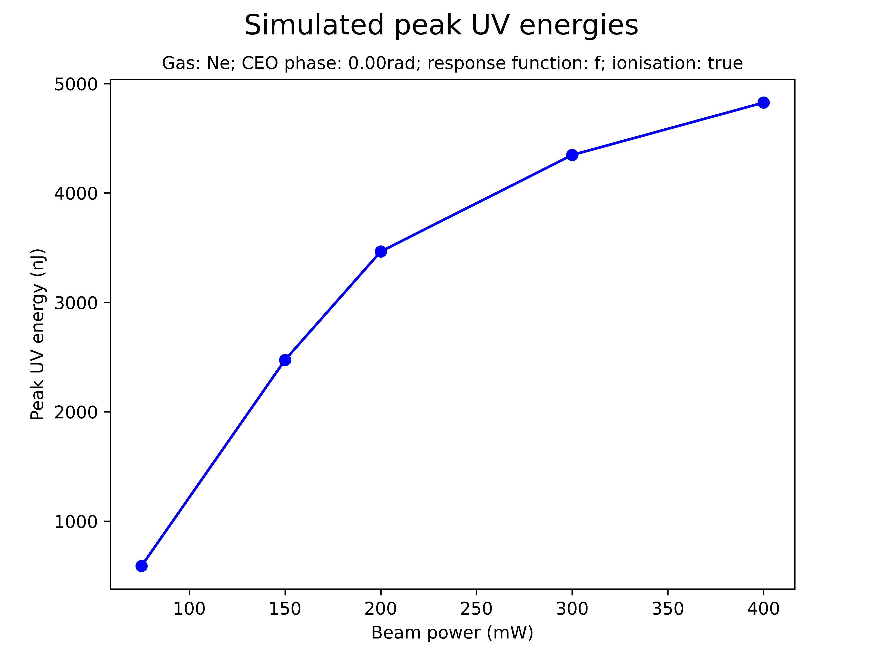
Effect of beam power on saturation

Slide 7
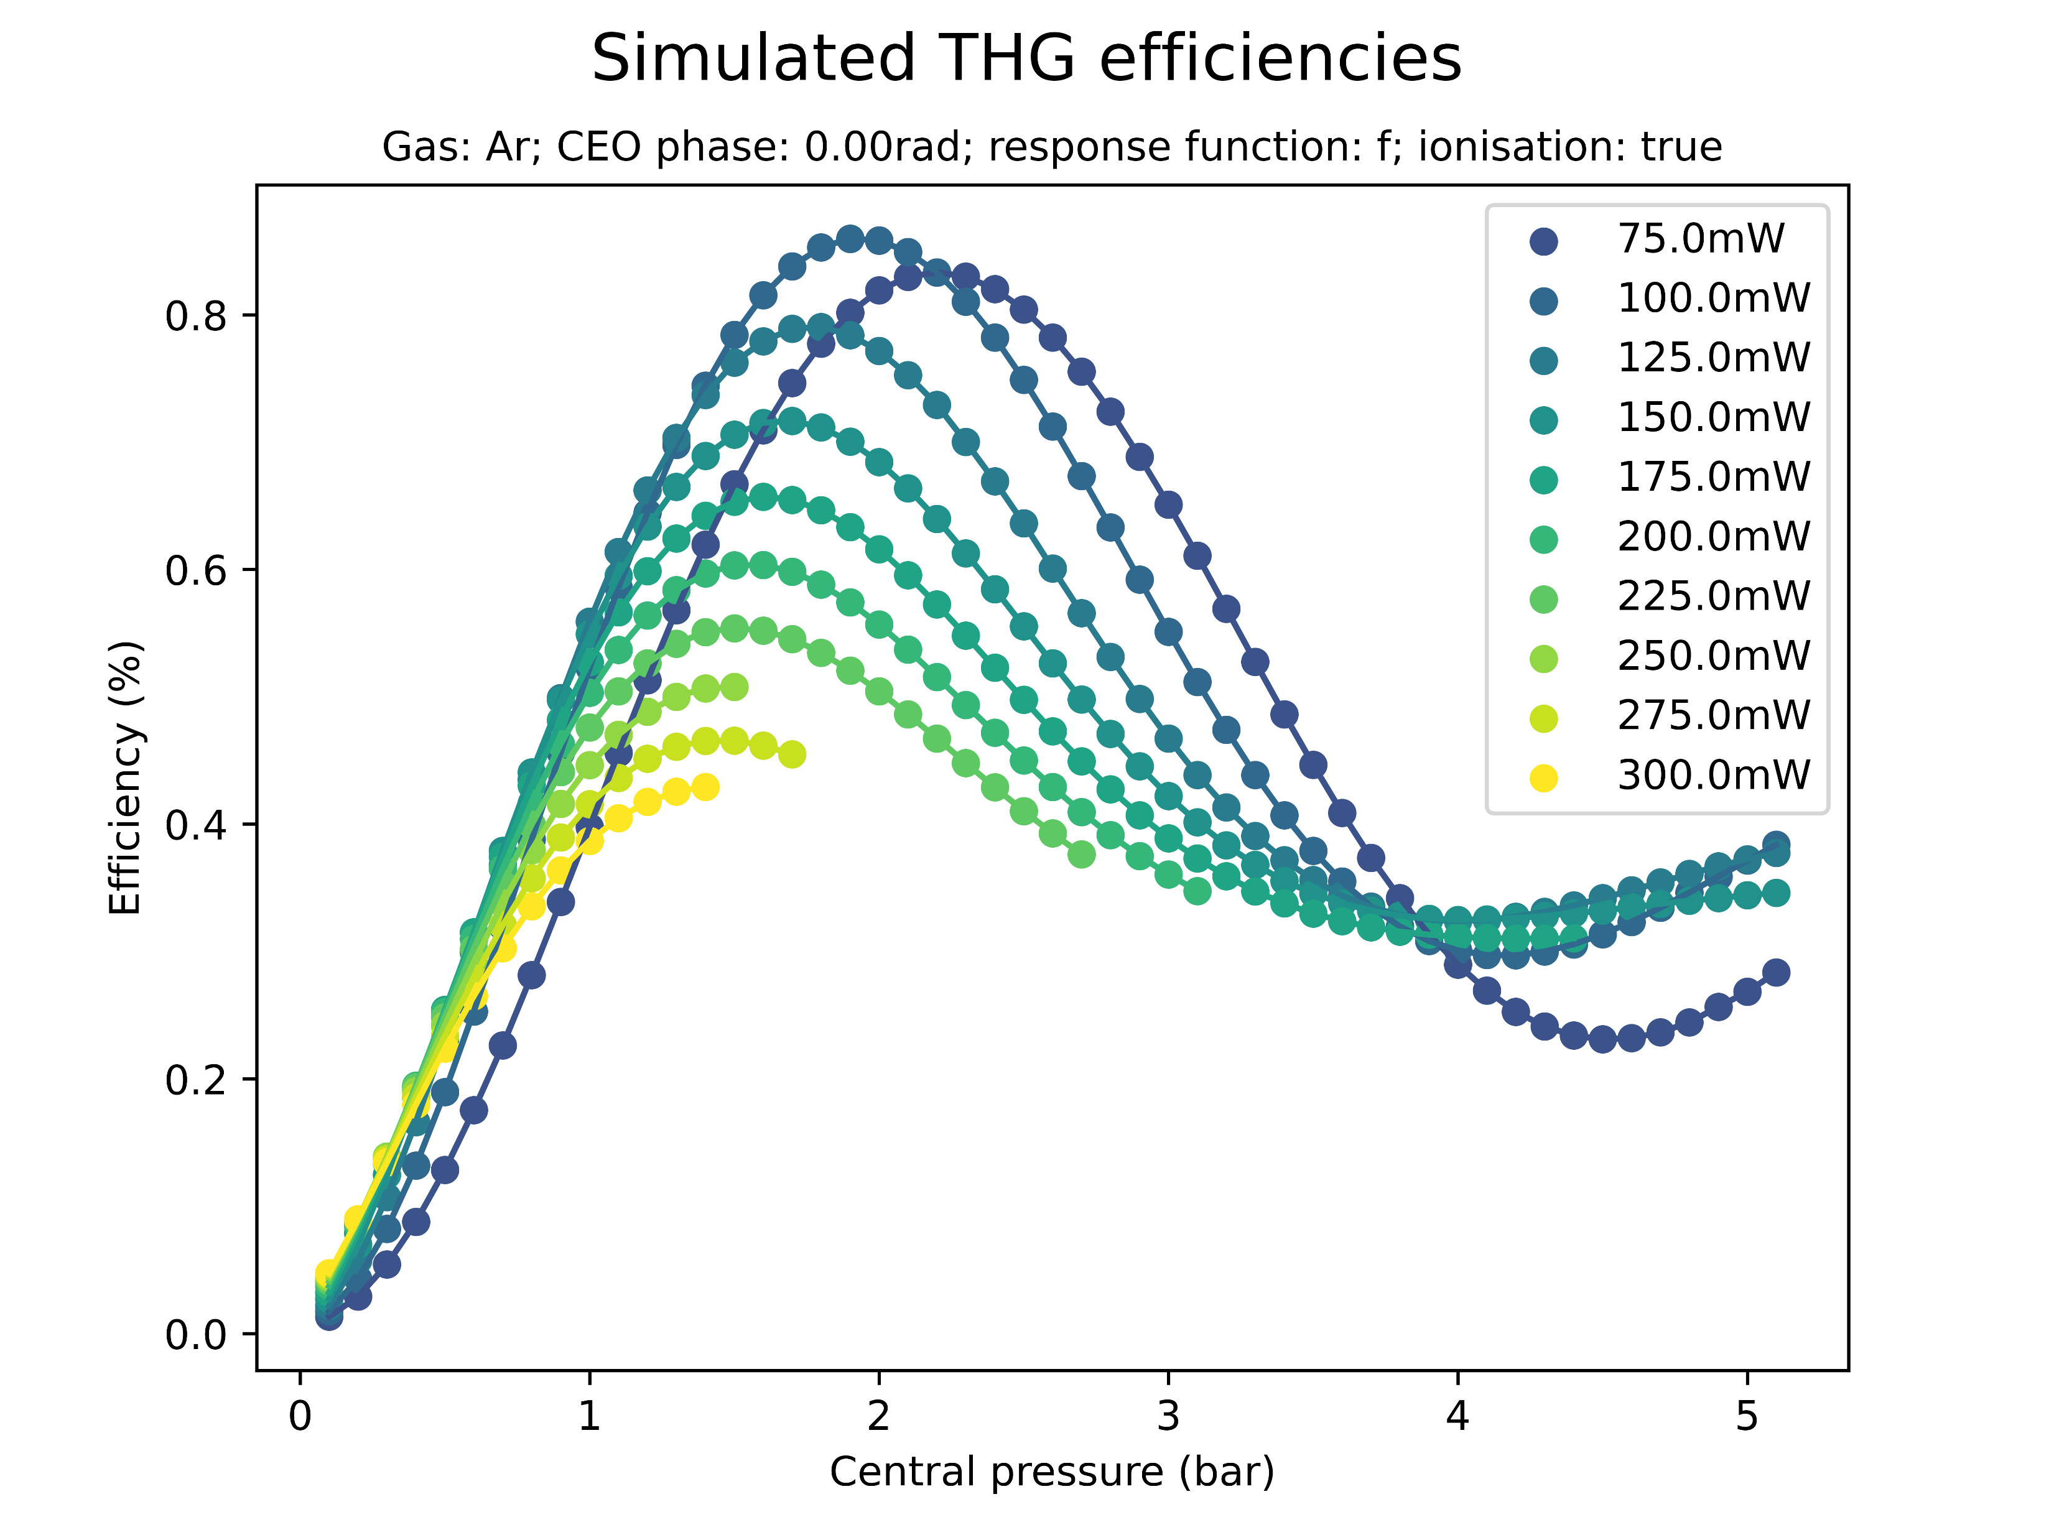
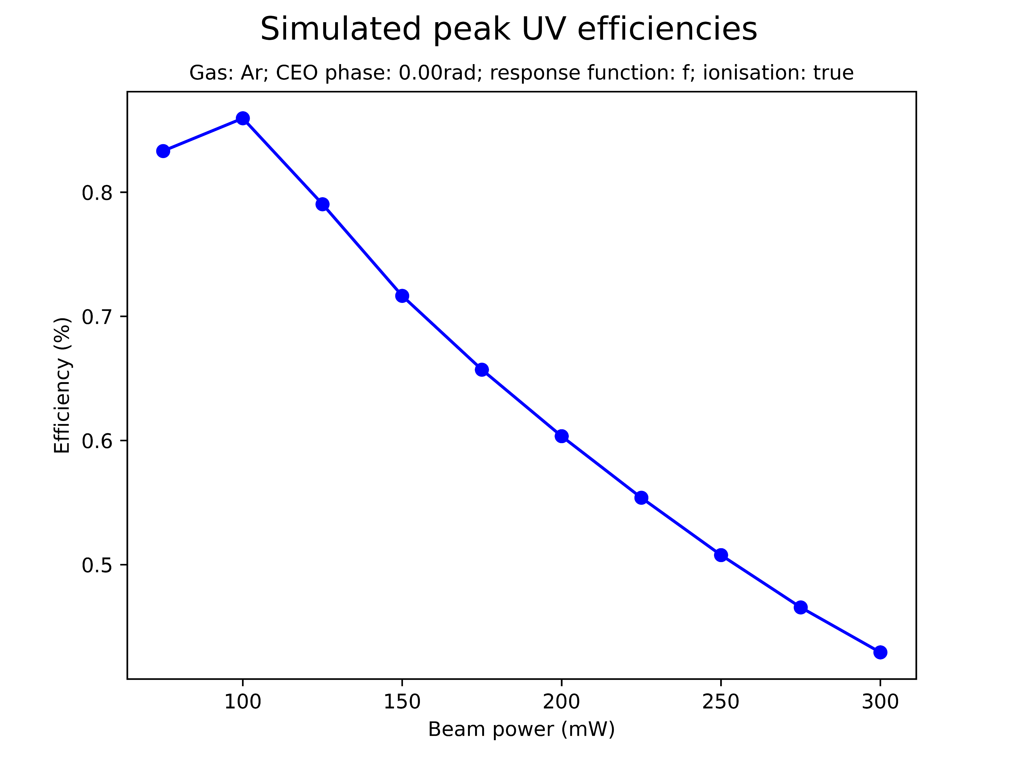
Effect of beam power on saturation

Slide 8
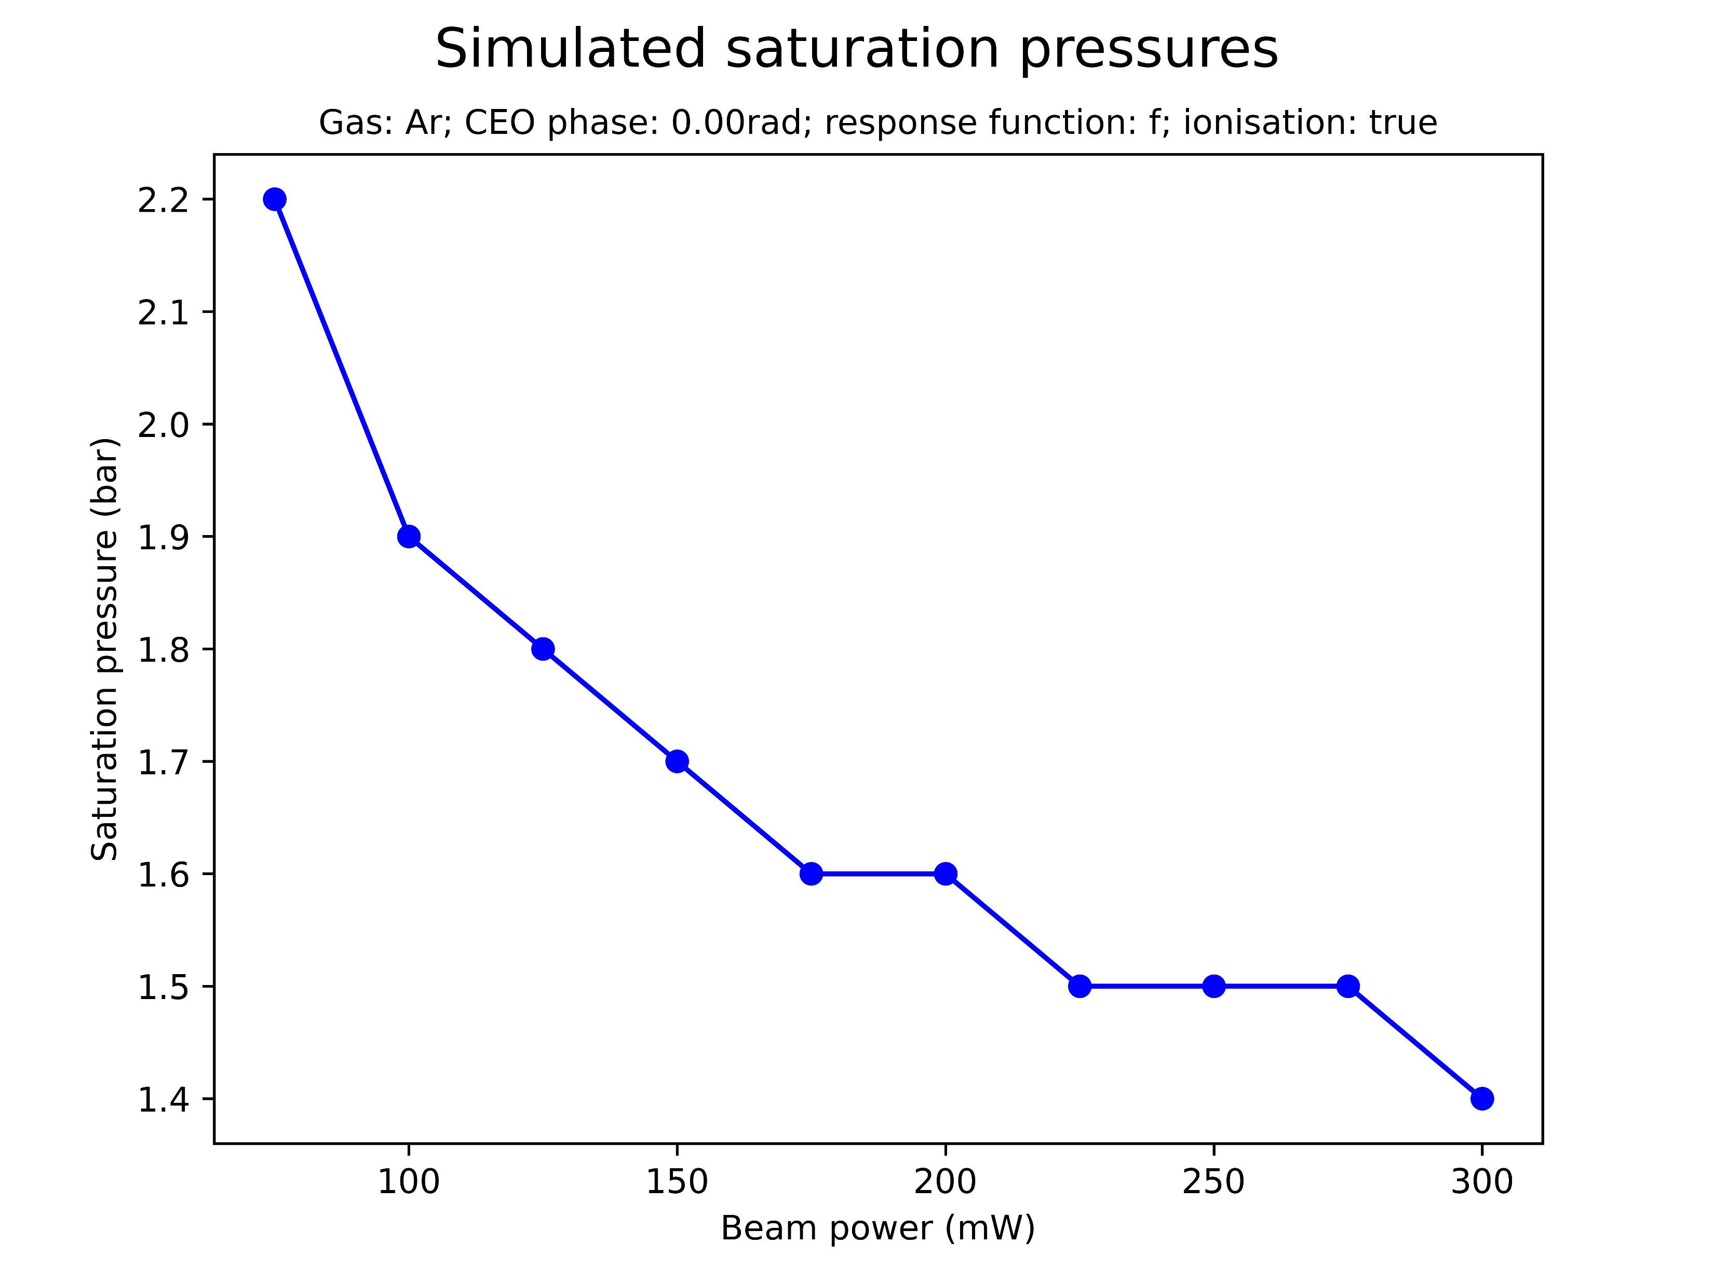
Effect of beam power on saturation
Increasing the beam power increases the peak UV energy and decreases the saturation pressure
The conversion efficiency peaks and then decreases, however
Notably, the peak UV is only increased up to a threshold
Note: same effects observed for Neon (next slide)

Slide 9
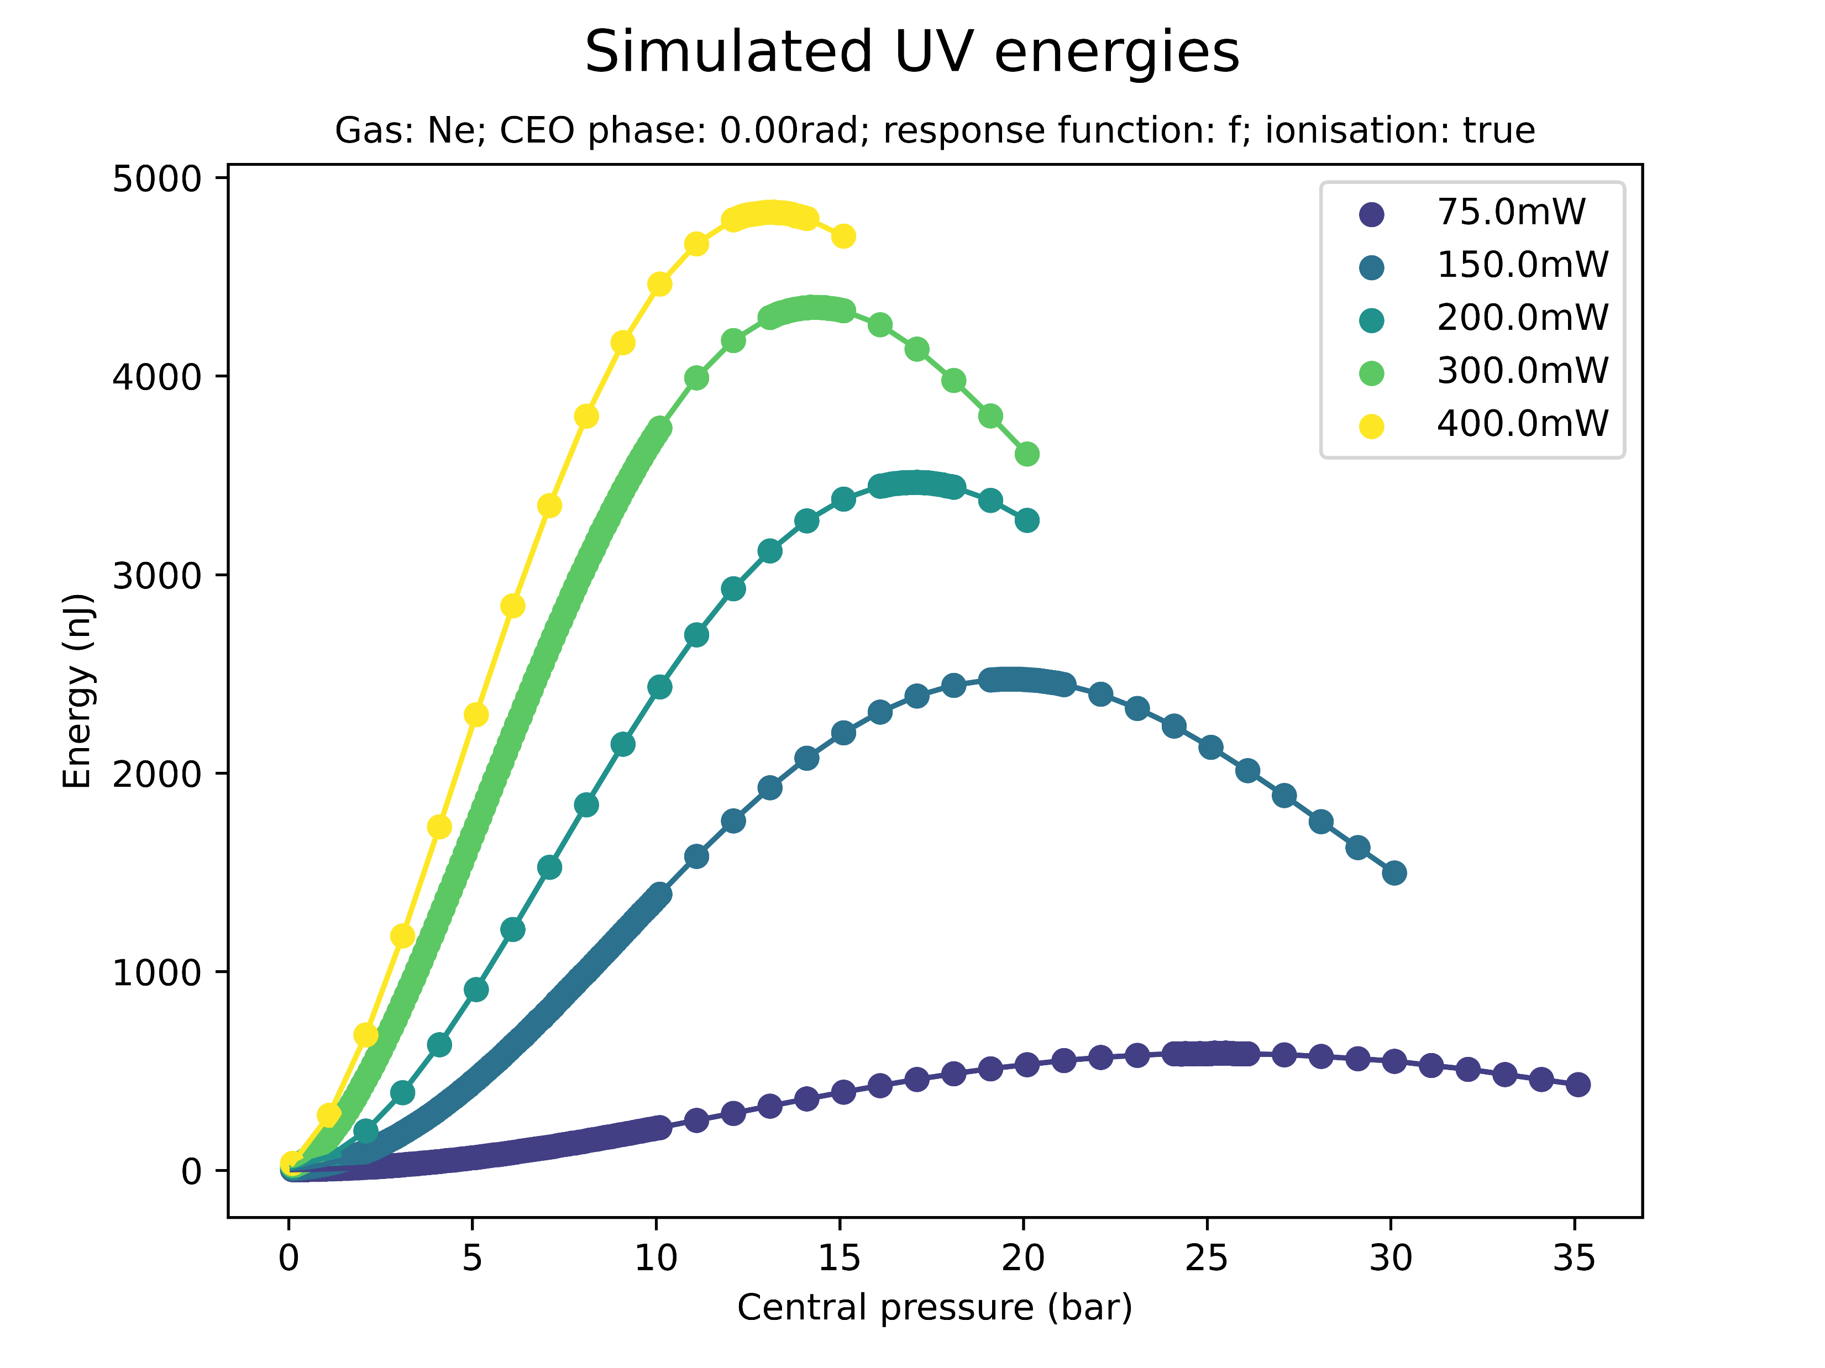
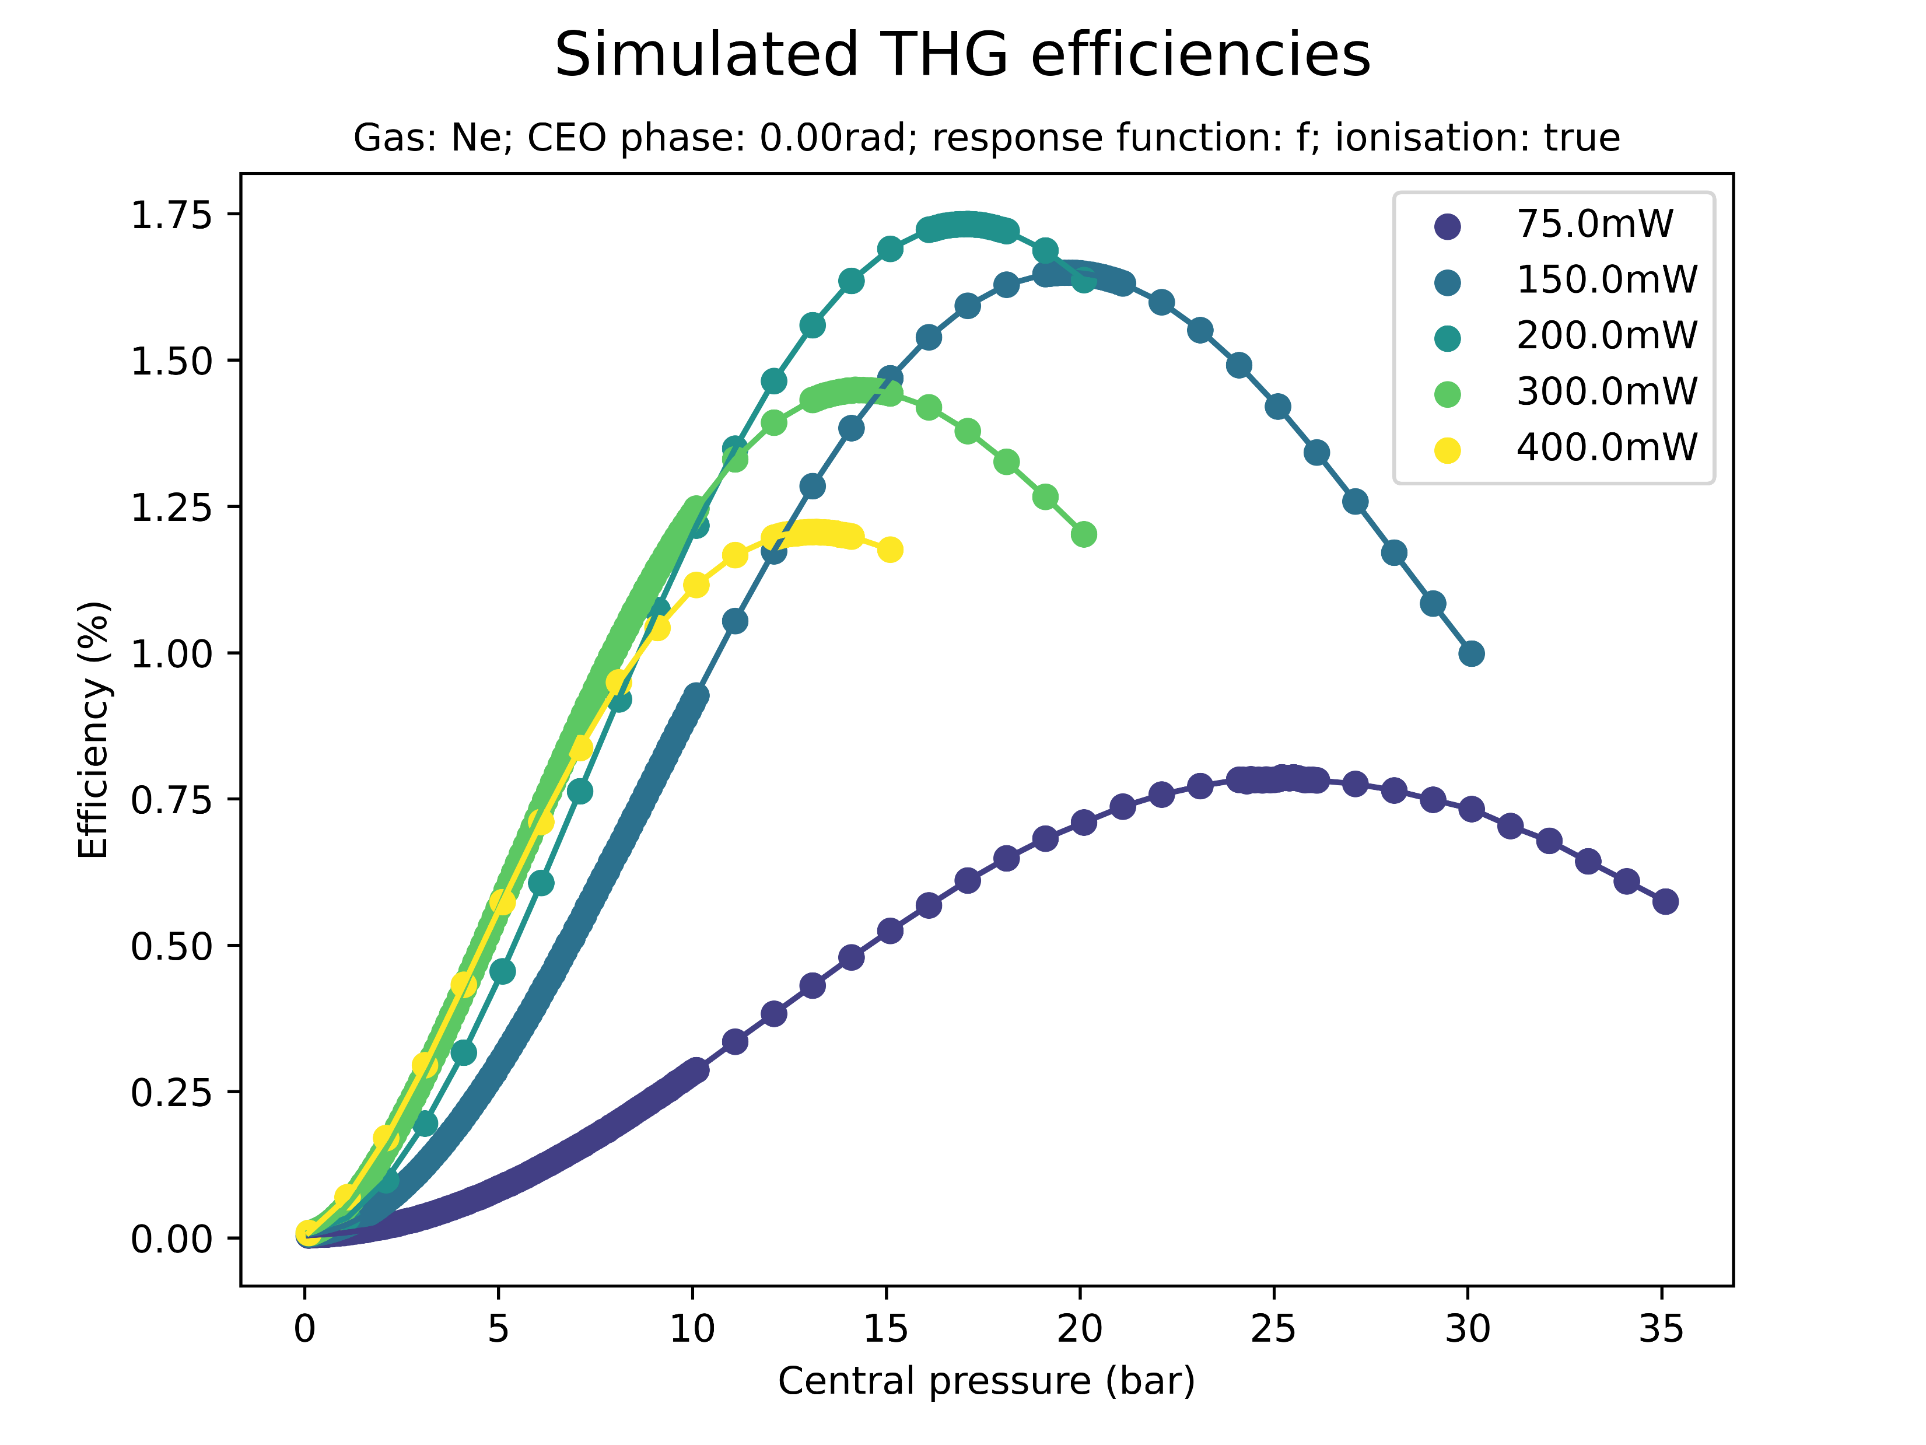
Effect of beam power on saturation (Ne)

Slide 10
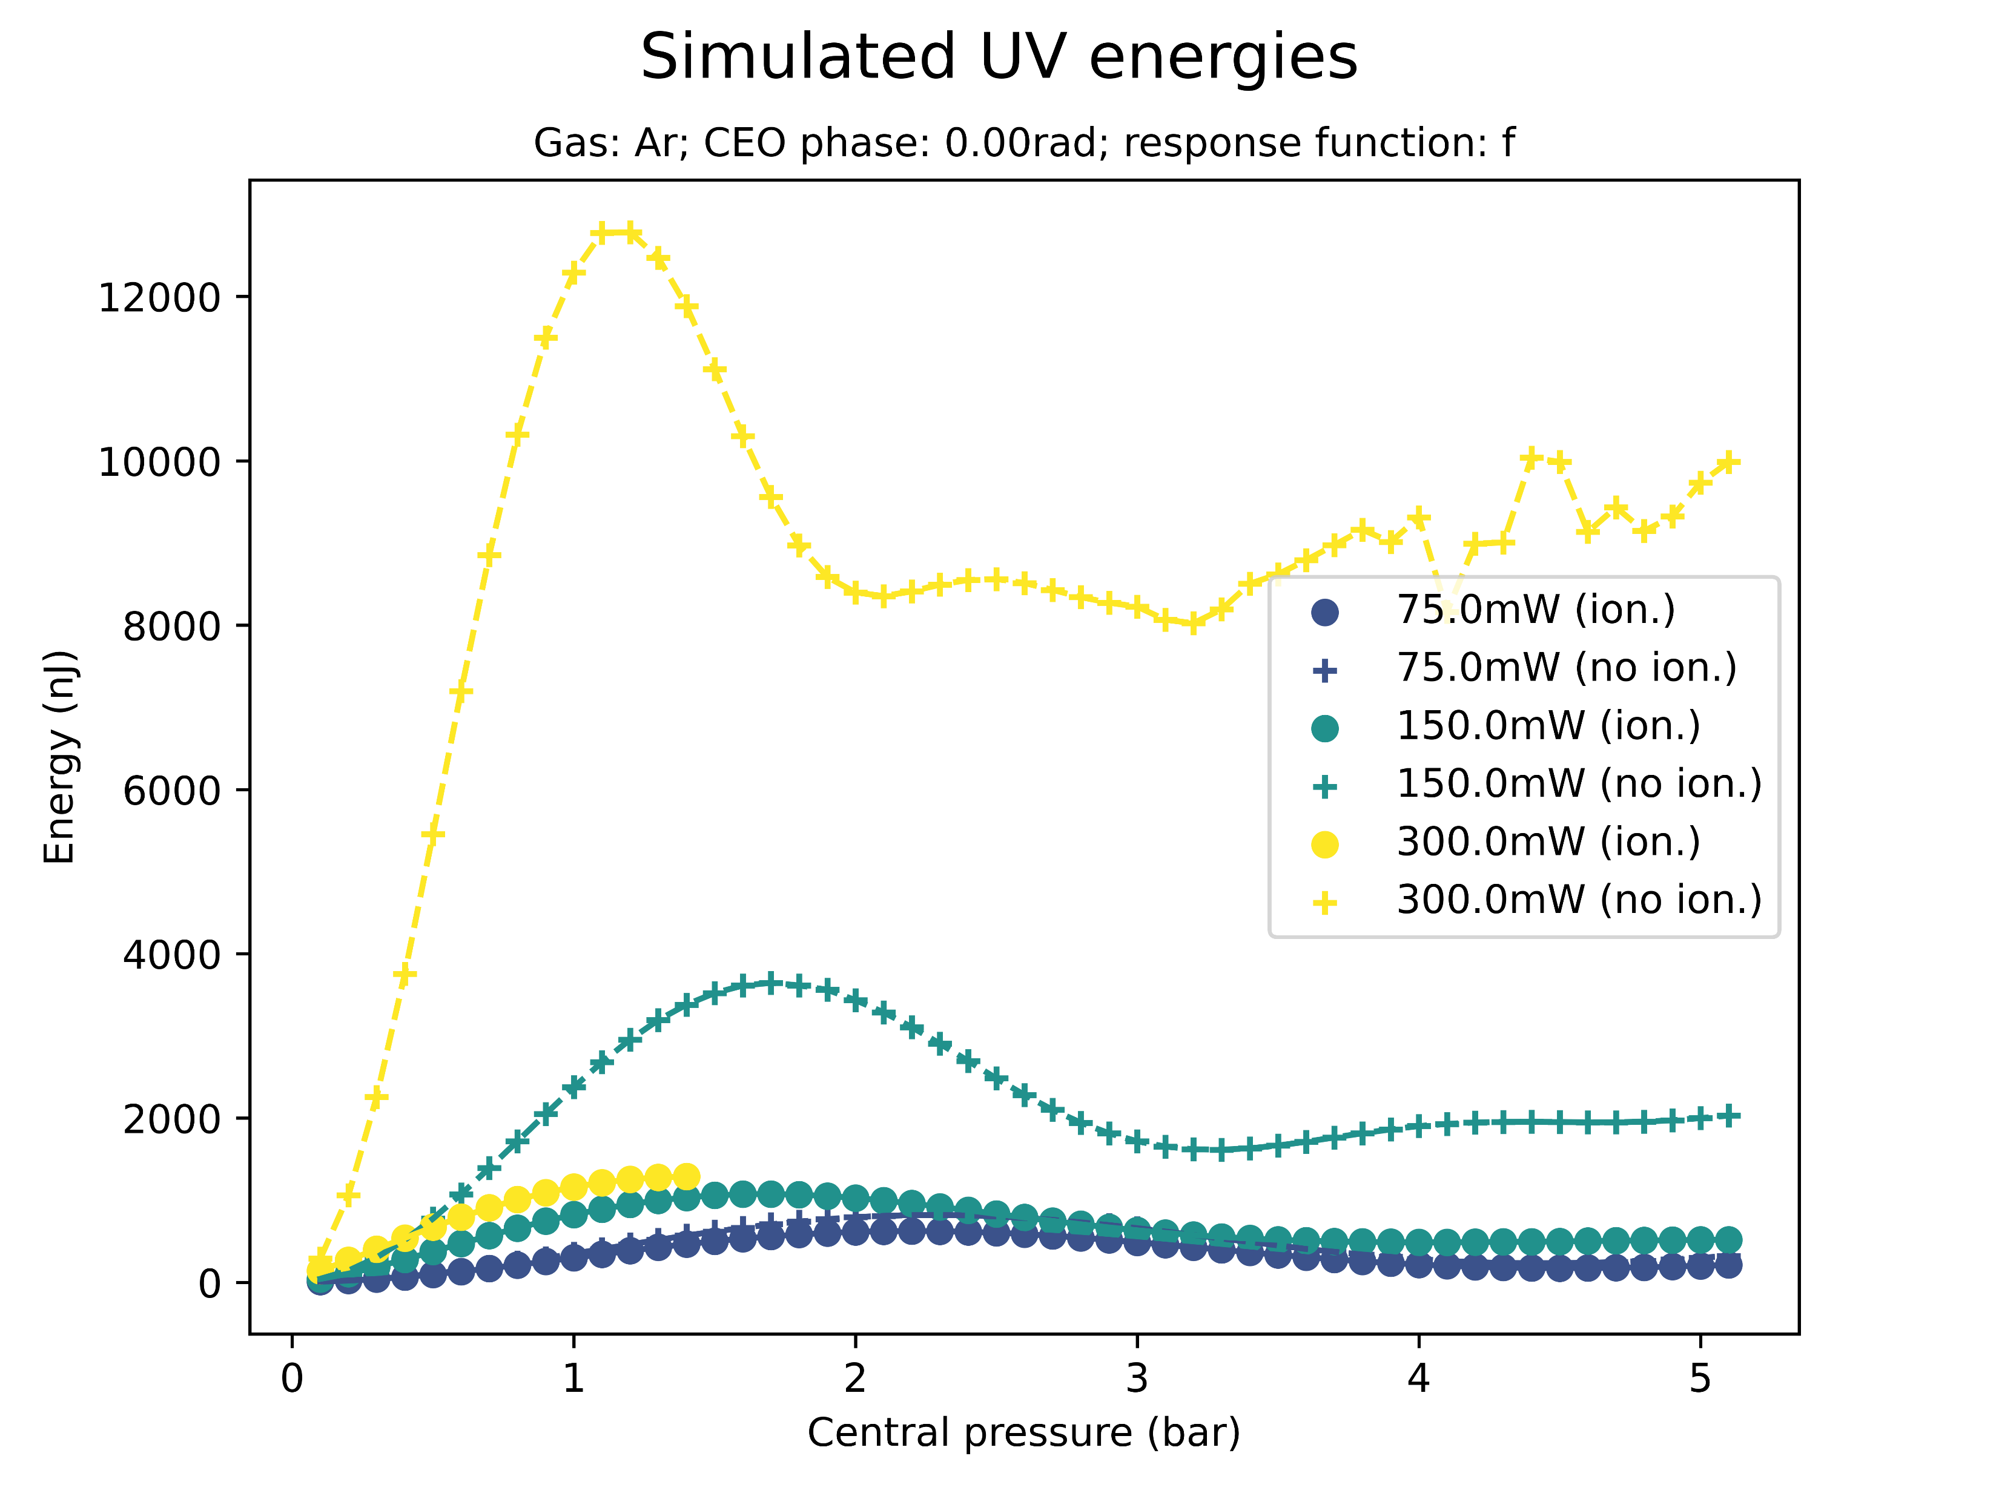
Effect of ionisation on saturation
Saturation sets in even when the ionisation response is turned off
However, at higher pressures, energies, and efficiencies
Again: same thing for Neon

Slide 11
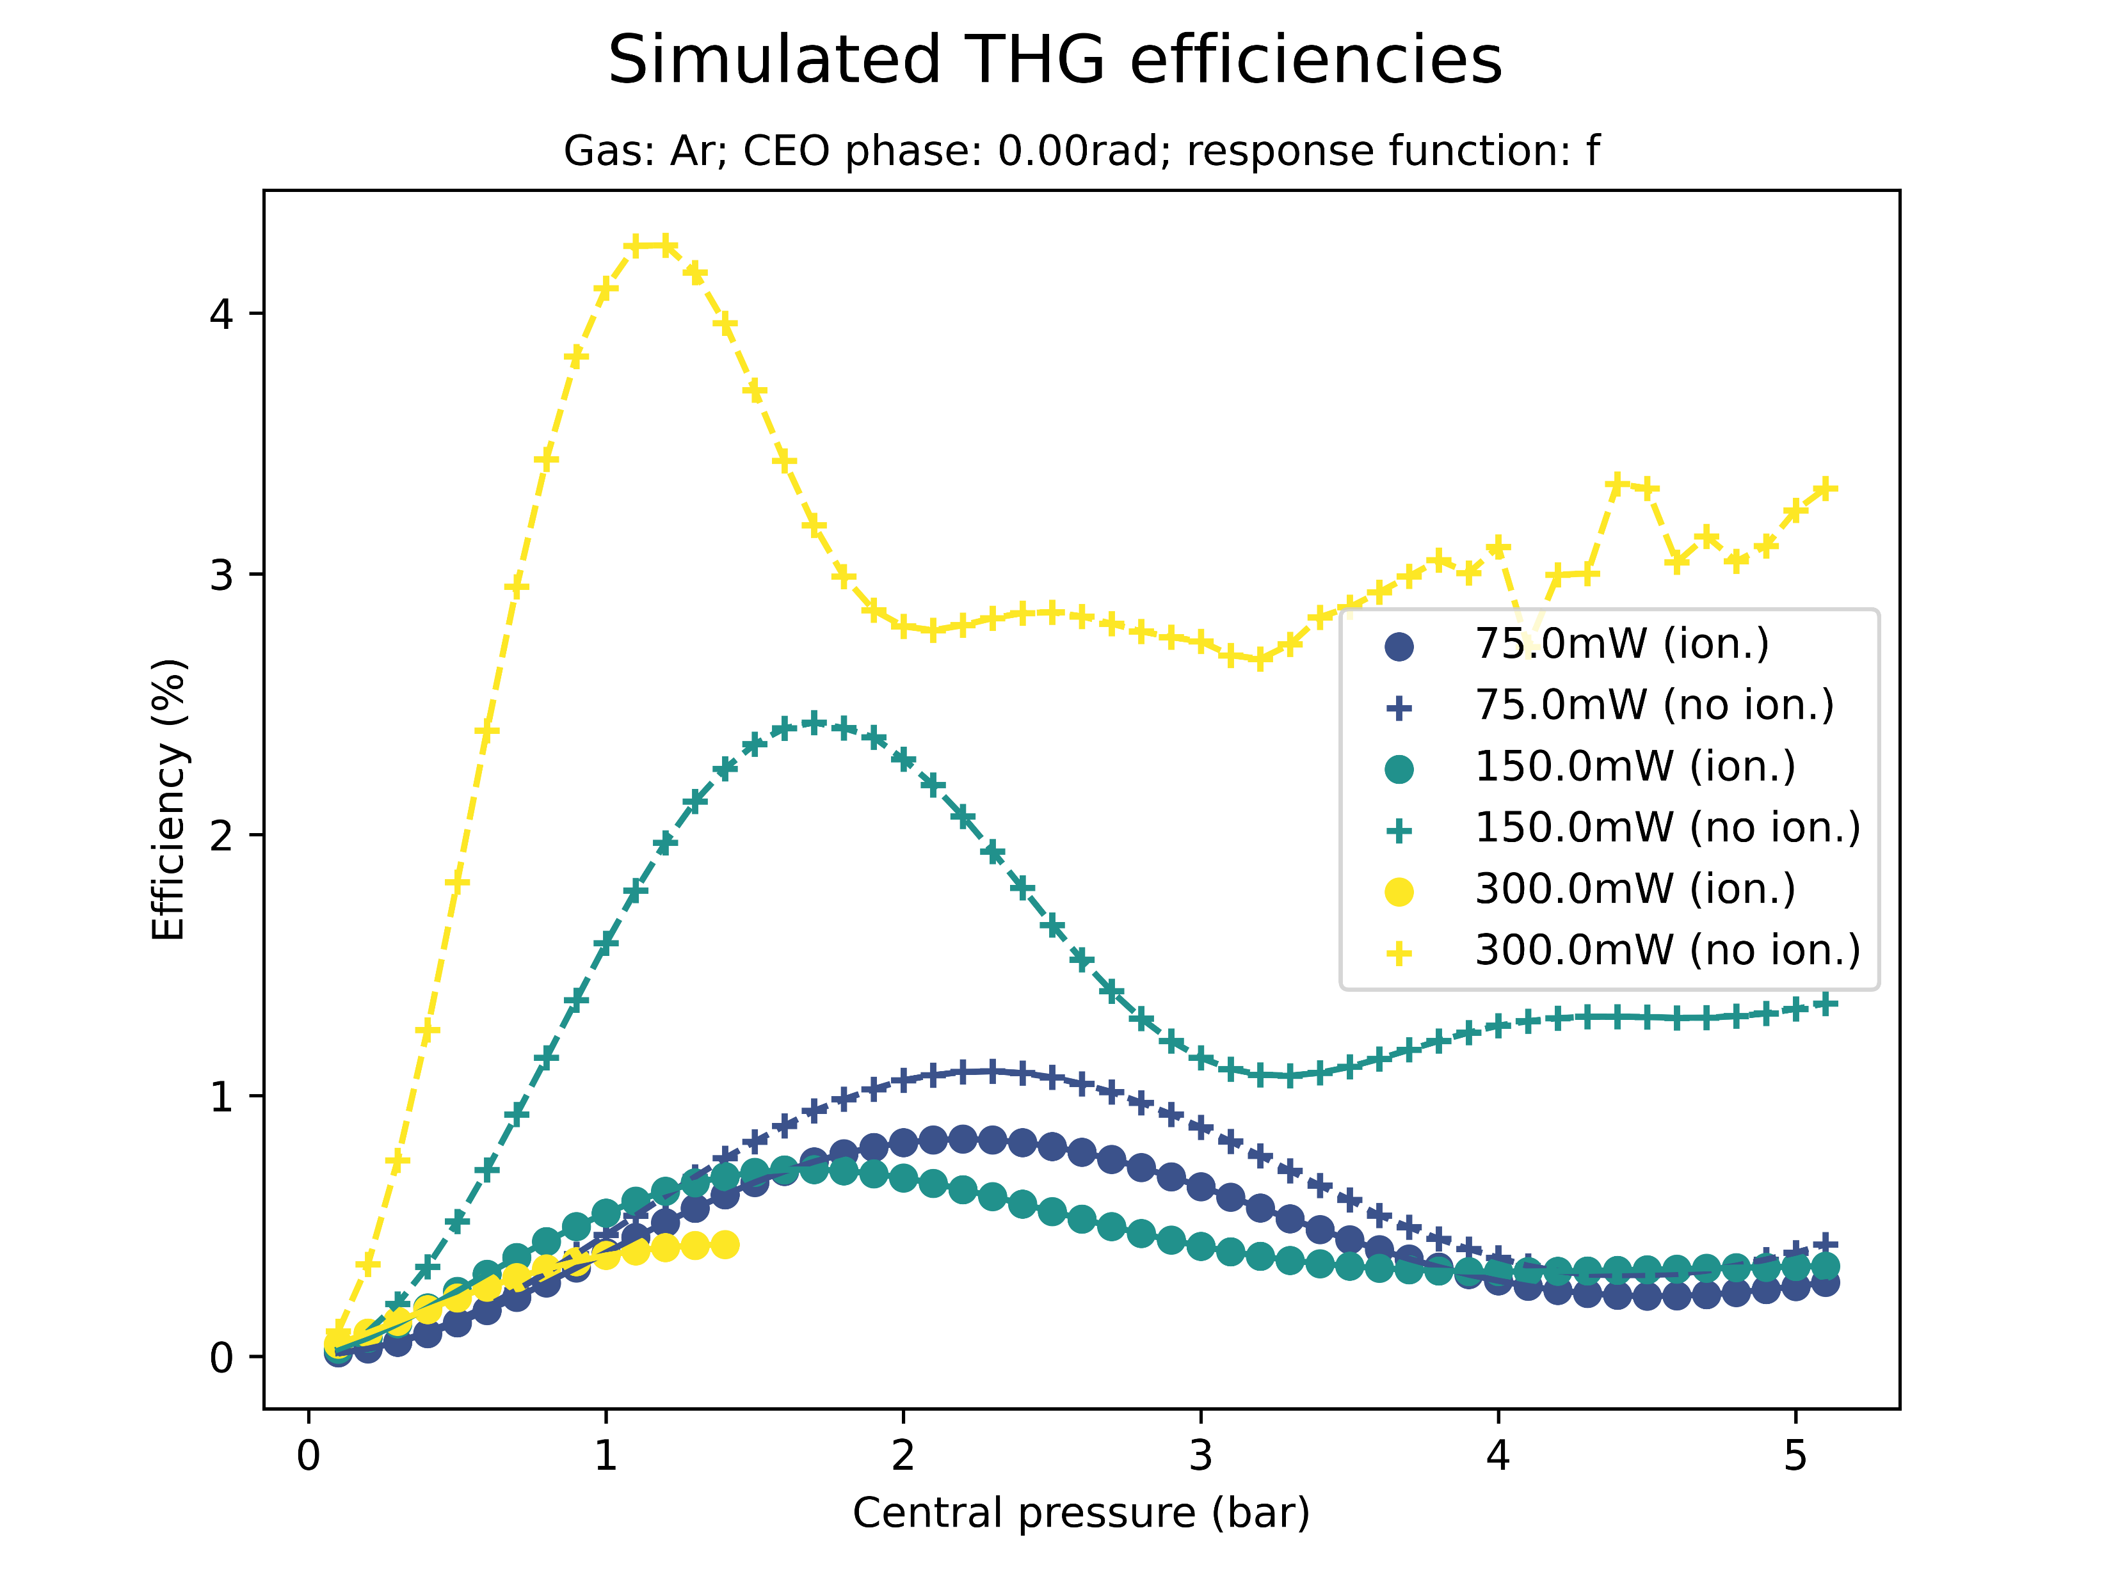
Effect of ionisation on saturation
Saturation sets in even when the ionisation response is turned off
However, at higher pressures, energies, and efficiencies

Slide 12
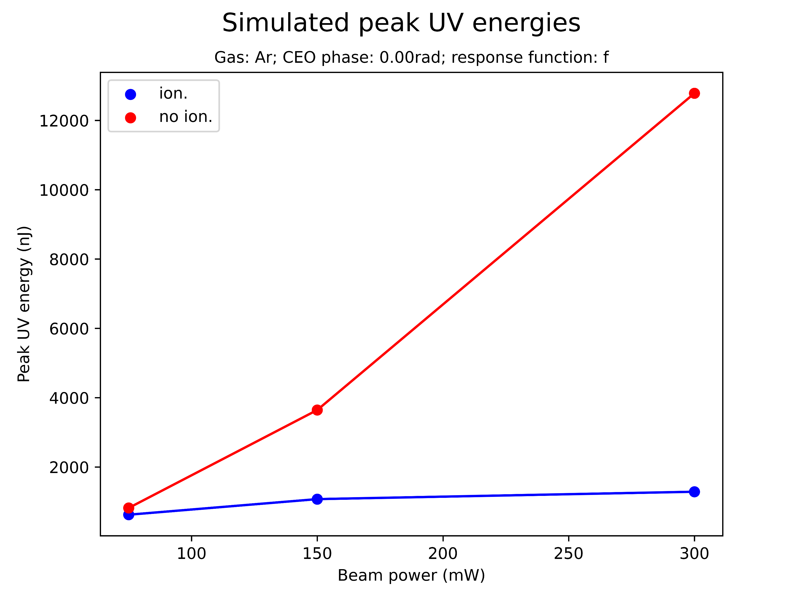
Effect of ionisation on saturation
Saturation sets in even when the ionisation response is turned off
However, at higher pressures, energies, and efficiencies
Not tested yet: threshold for UV peak energy? Peak of conversion efficiency?

Slide 13
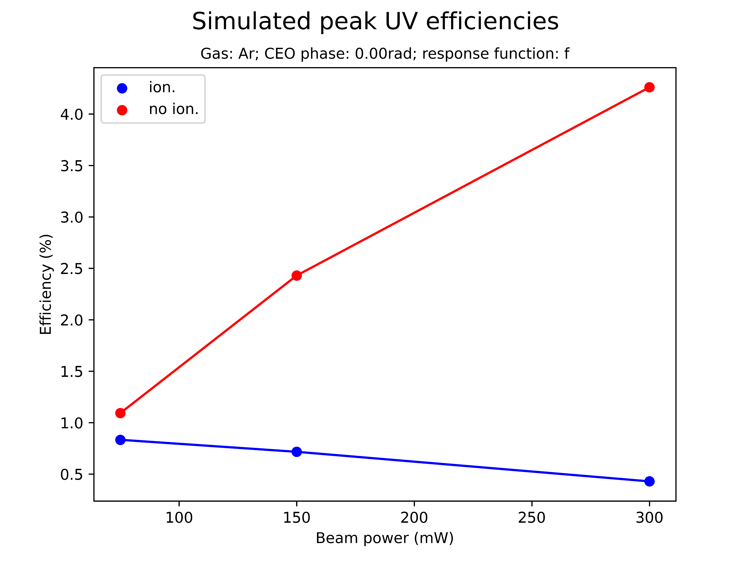
Effect of ionisation on saturation
Saturation sets in even when the ionisation response is turned off
However, at higher pressures, energies, and efficiencies
NOTE: conversion efficiency seems to go up?? Surely energy and efficiency will plateau eventually??
More waffle!!!

Slide 14
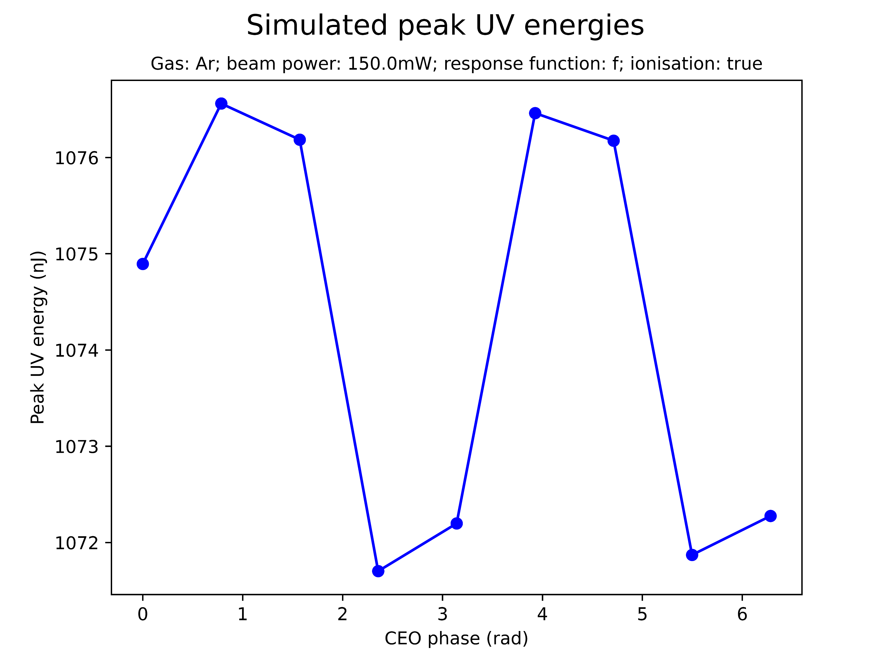
Effect of CEO phase on saturation
Sinusoidal variation of peak UV energy/peak THG efficiency with CEO phase
The amplitude of the oscillation is negligible
CEO phase can be set to zero without significant effect on saturation
Test this more? (only tested for Ar at 150mW!)

Slide 15
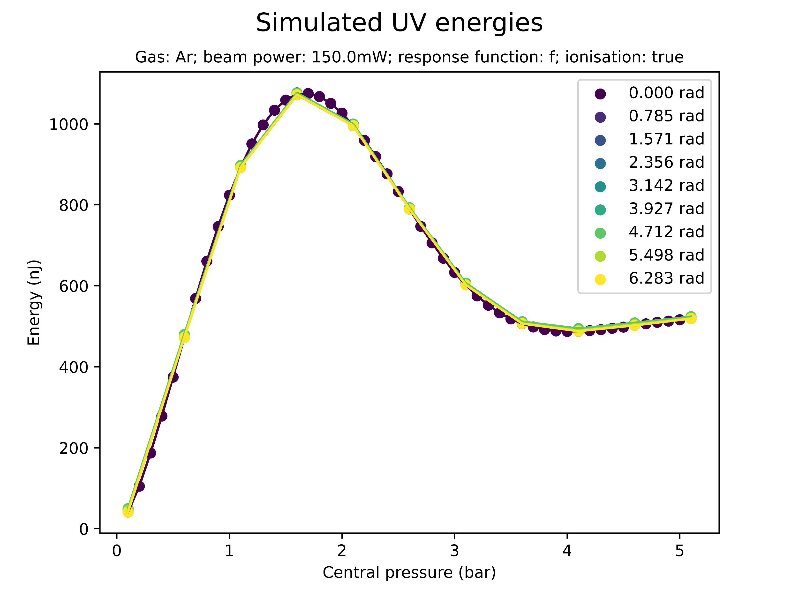
Effect of CEO phase on saturation
Sinusoidal variation of peak UV energy/peak THG efficiency with CEO phase
The amplitude of the oscillation is negligible
CEO phase can be set to zero without significant loss of accuracy
Test this more? (only tested for Ar at 150mW!)

Slide 16
Summary: saturation
How can you explain quantitative differences??
Energy/efficiency not unphysically high but 1 order of magnitude higher than measured!
Pressure is factor 4 larger! Can this be explained due to measurement outside the cell (instead of inside)?
Need to run some Ne scans for higher pressures

Slide 17
II. SPECTRAL PEAKS

Slide 18
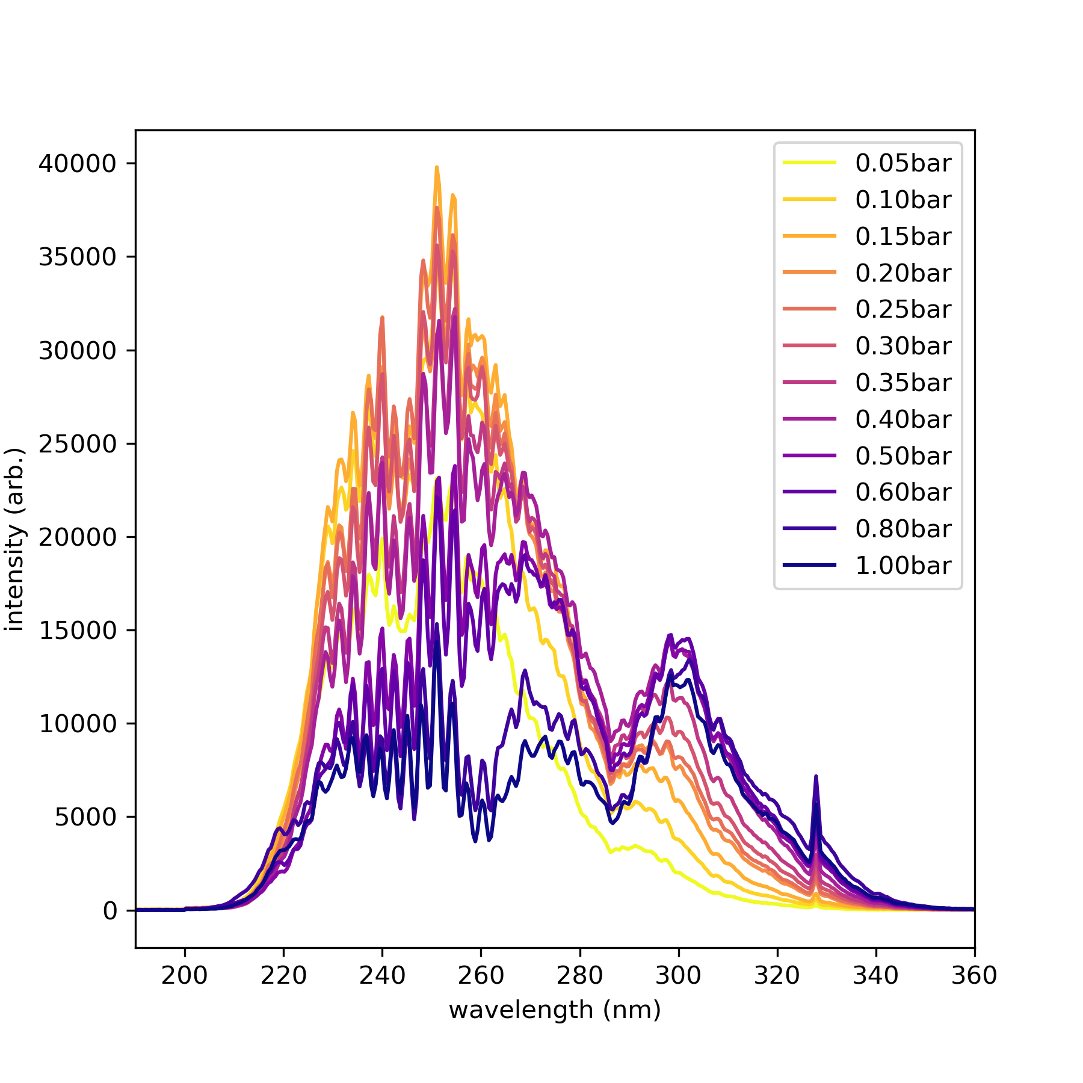
Spectral profile
Measured: At at 300mW
Intro waffle:
not just peak at THG…
At pressures beyond the saturation pressure: extra peaks …. Are measured
Could be reproduced by simulations…

Slide 19
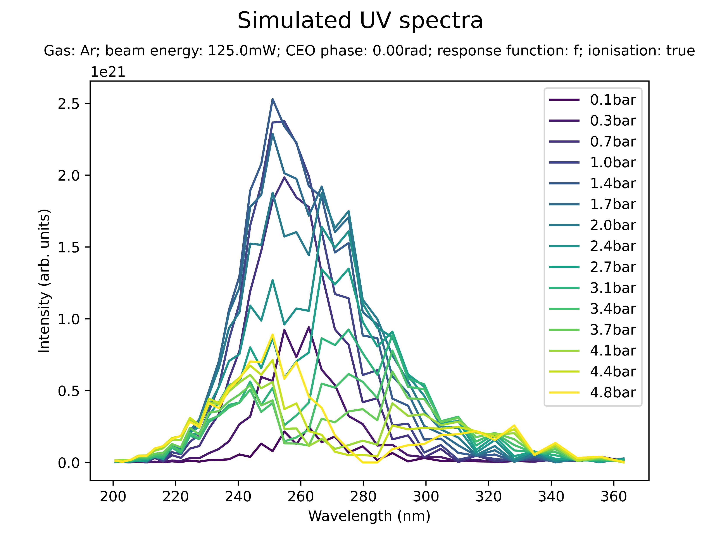
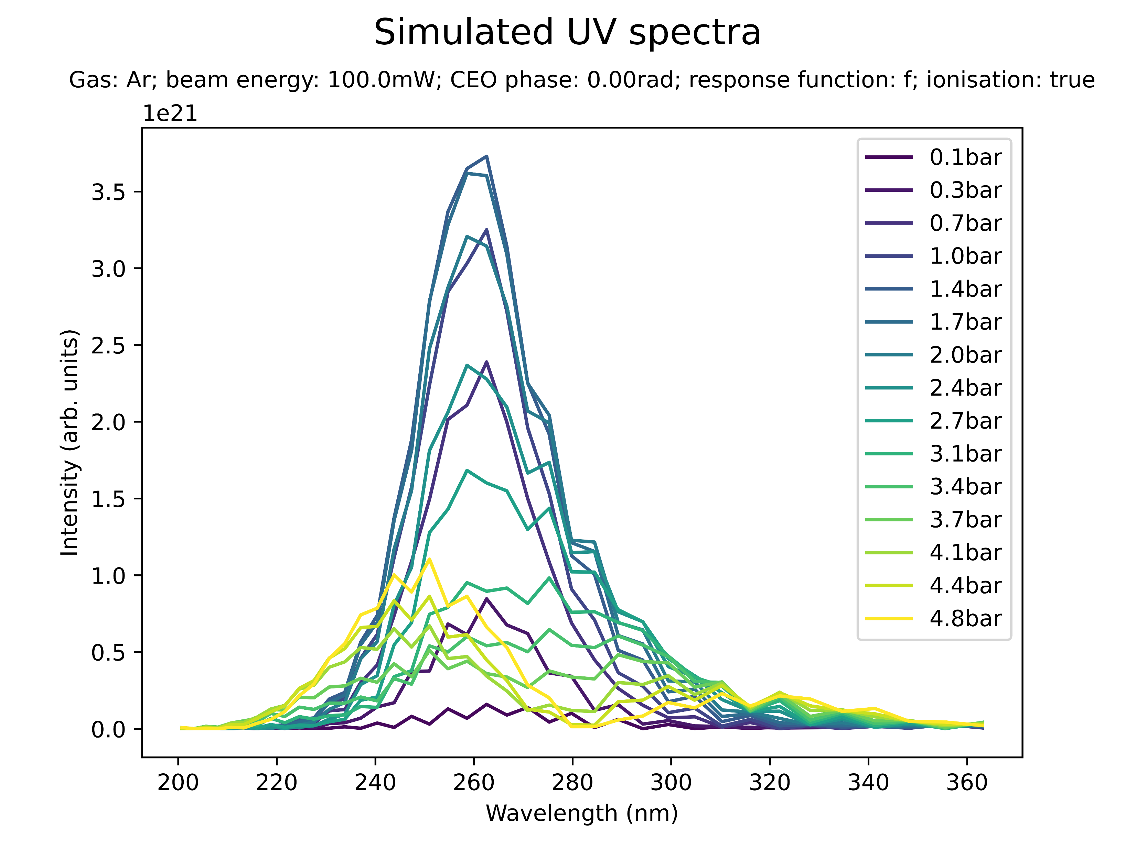
Effect of beam power on spectral peaks
Low power (Ar)

Slide 20
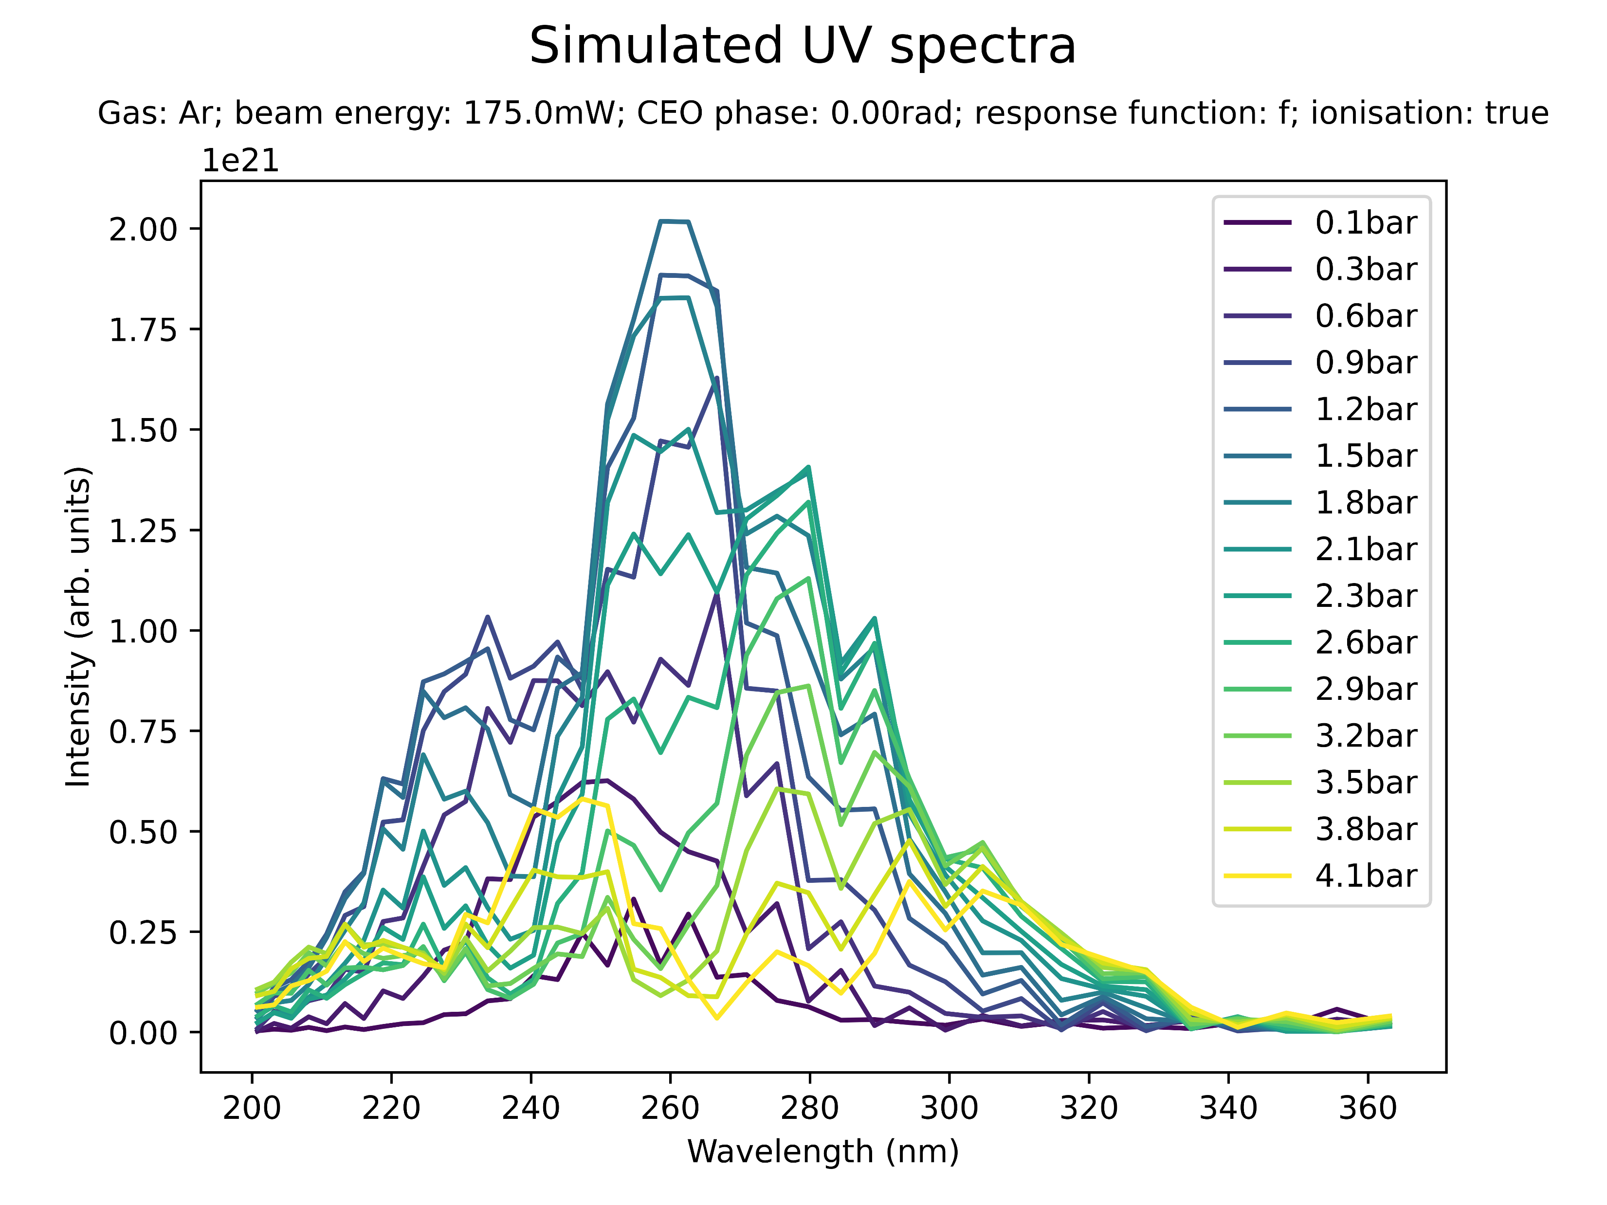
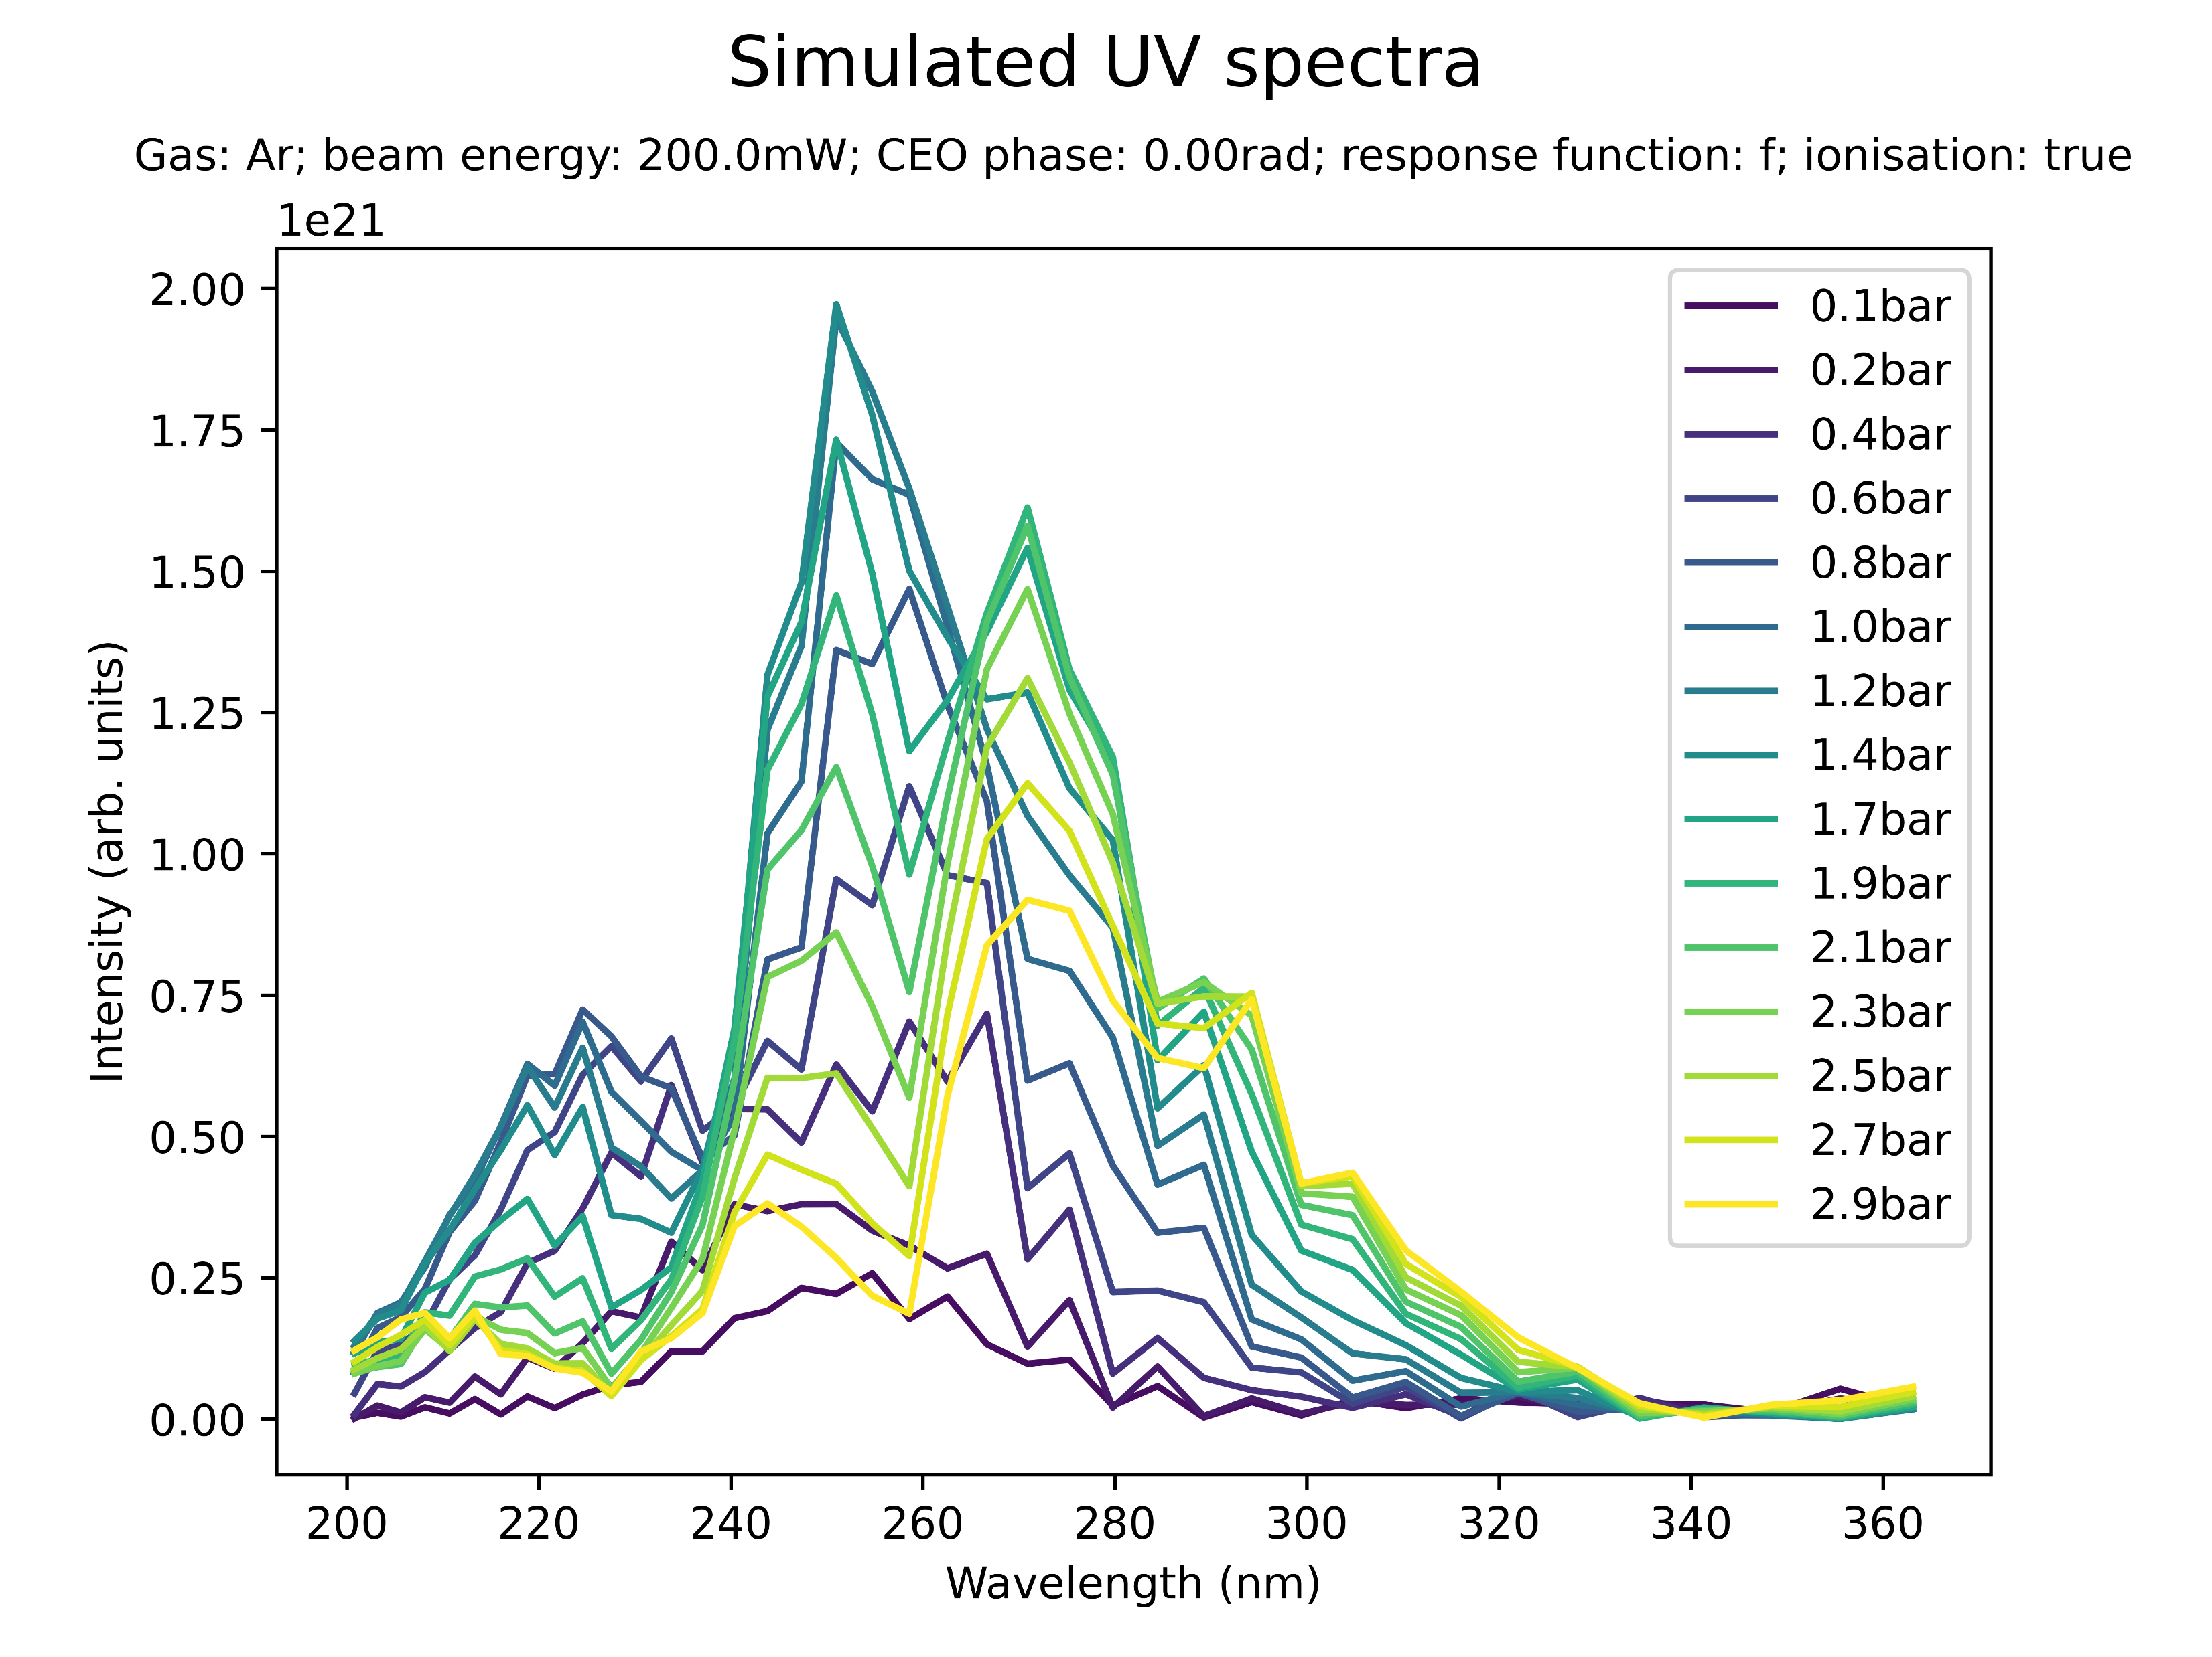
Effect of beam power on spectral peaks
Medium power (Ar)

Slide 21
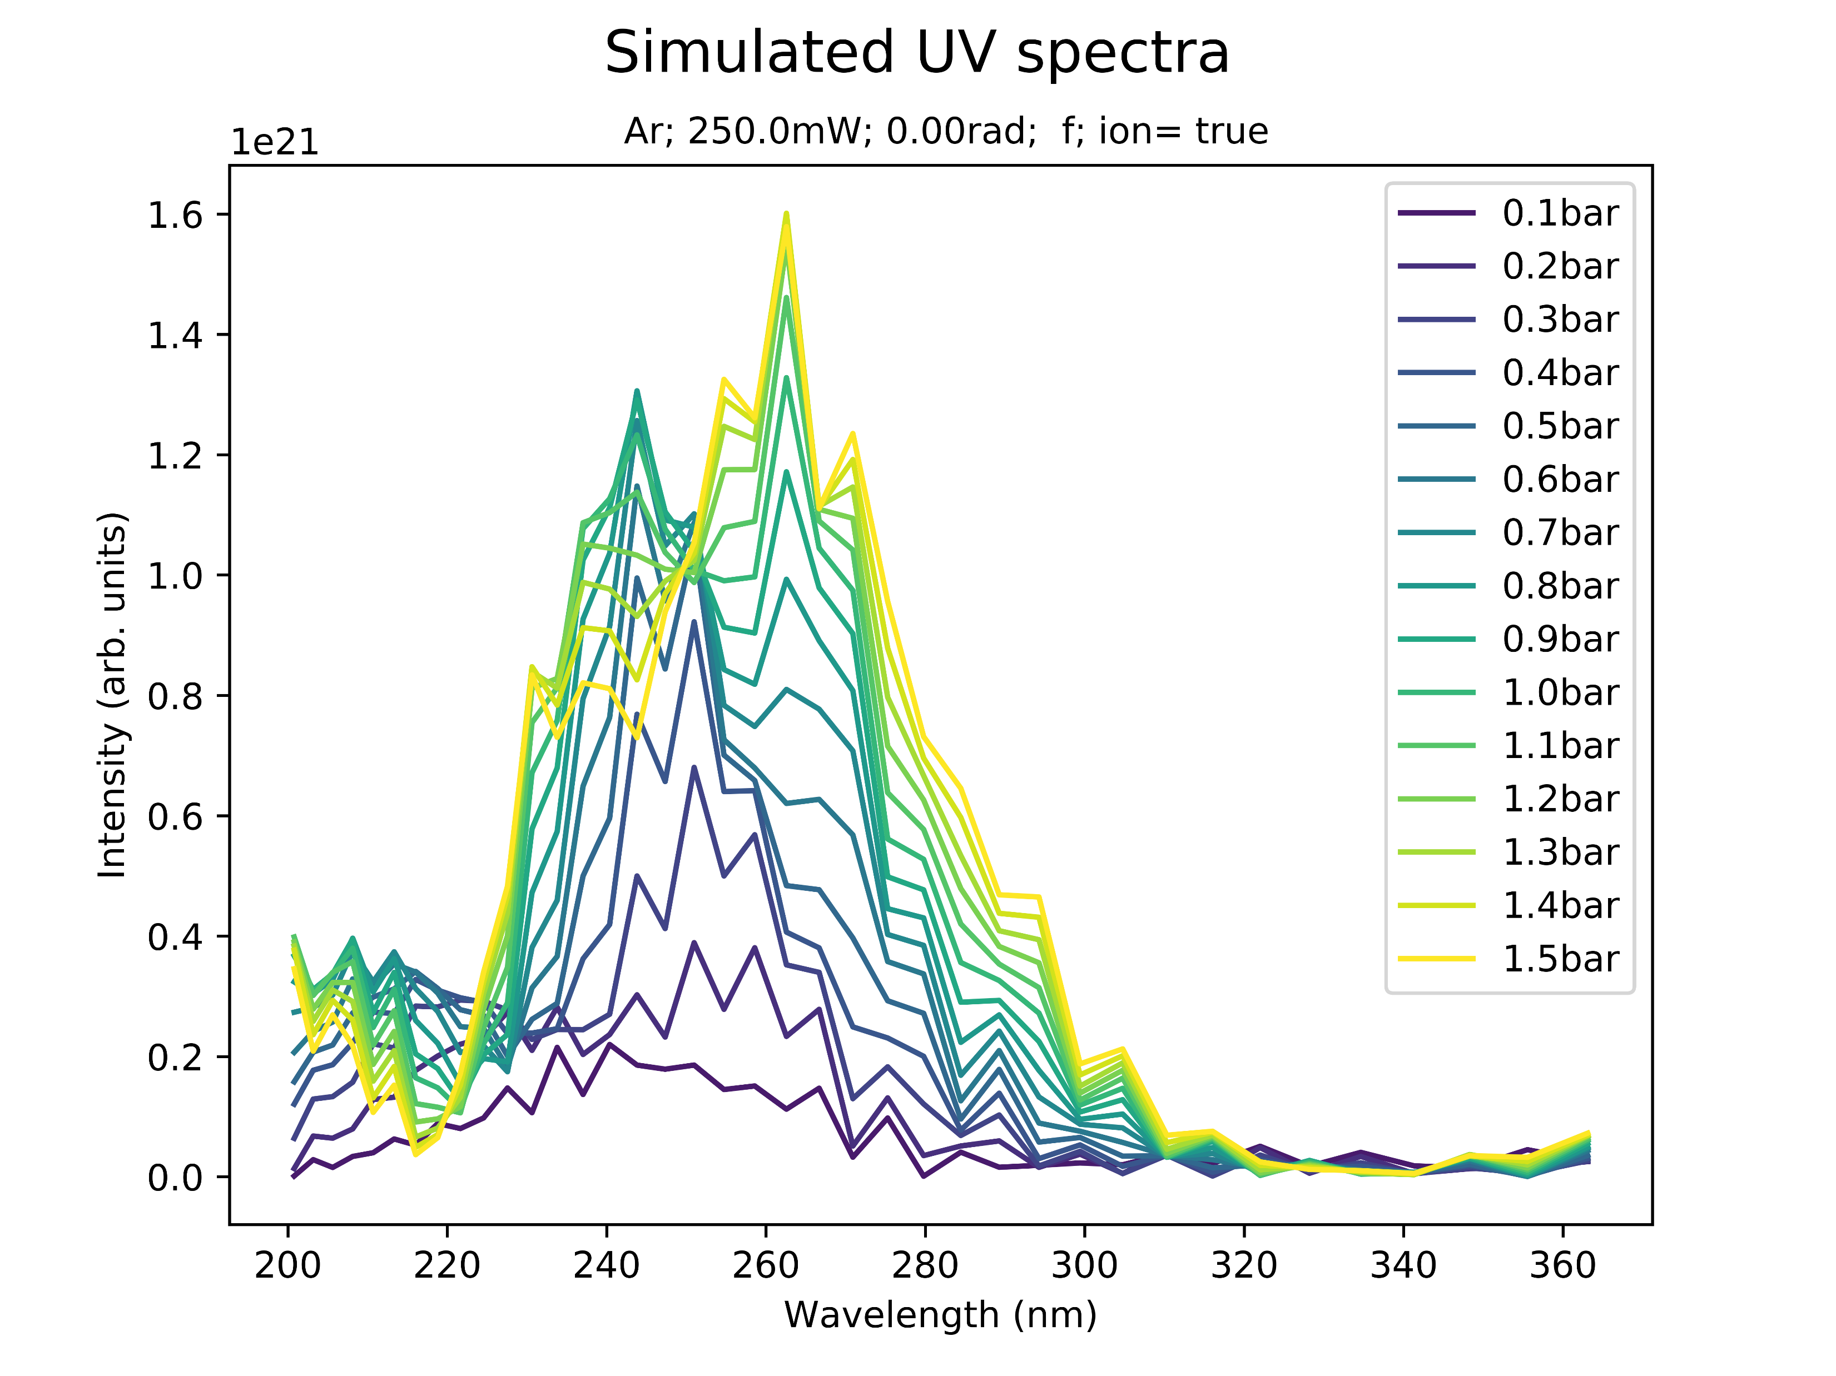
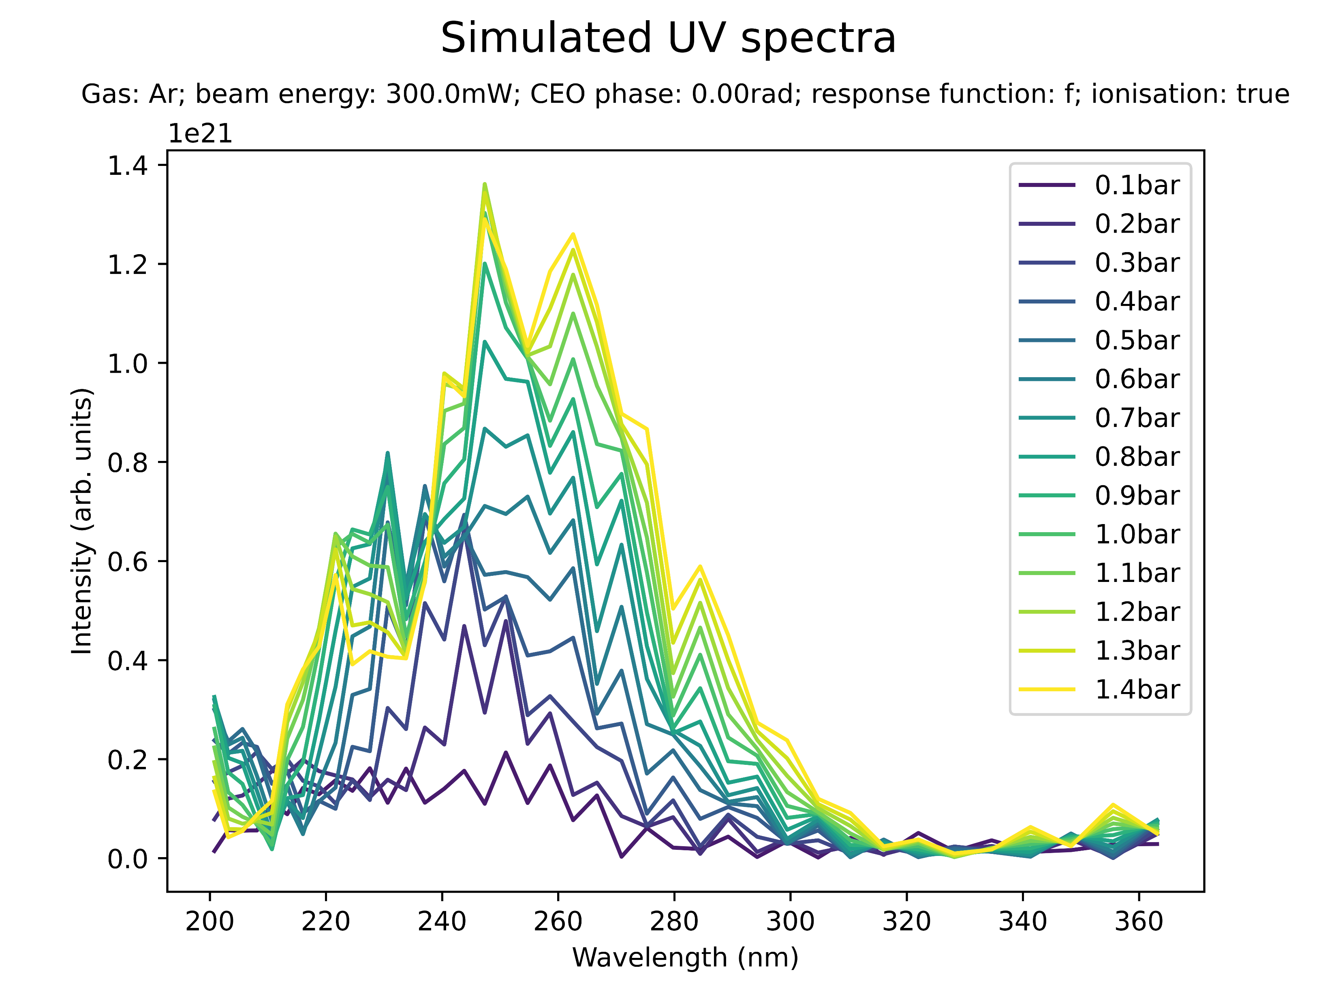
Effect of beam power on spectral peaks
High power (Ar)

Slide 22
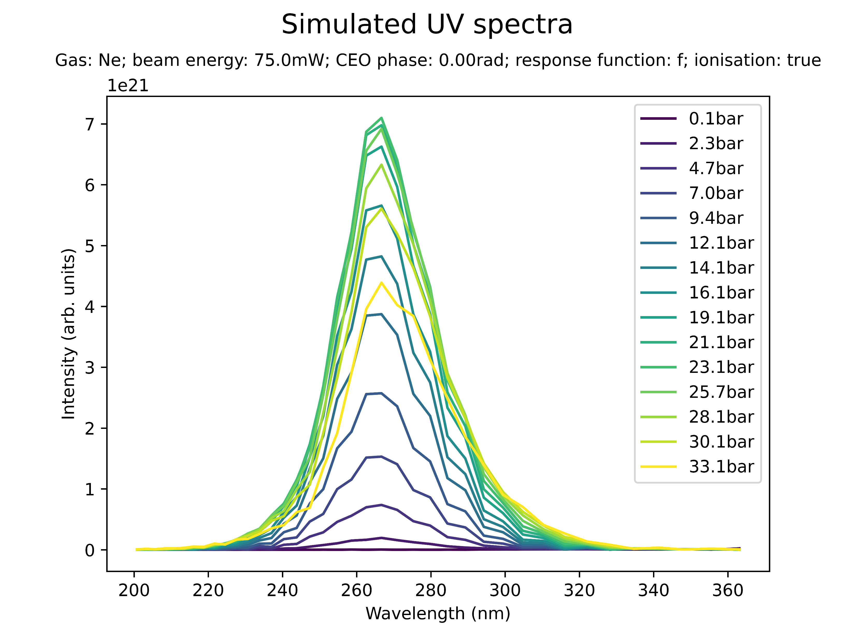
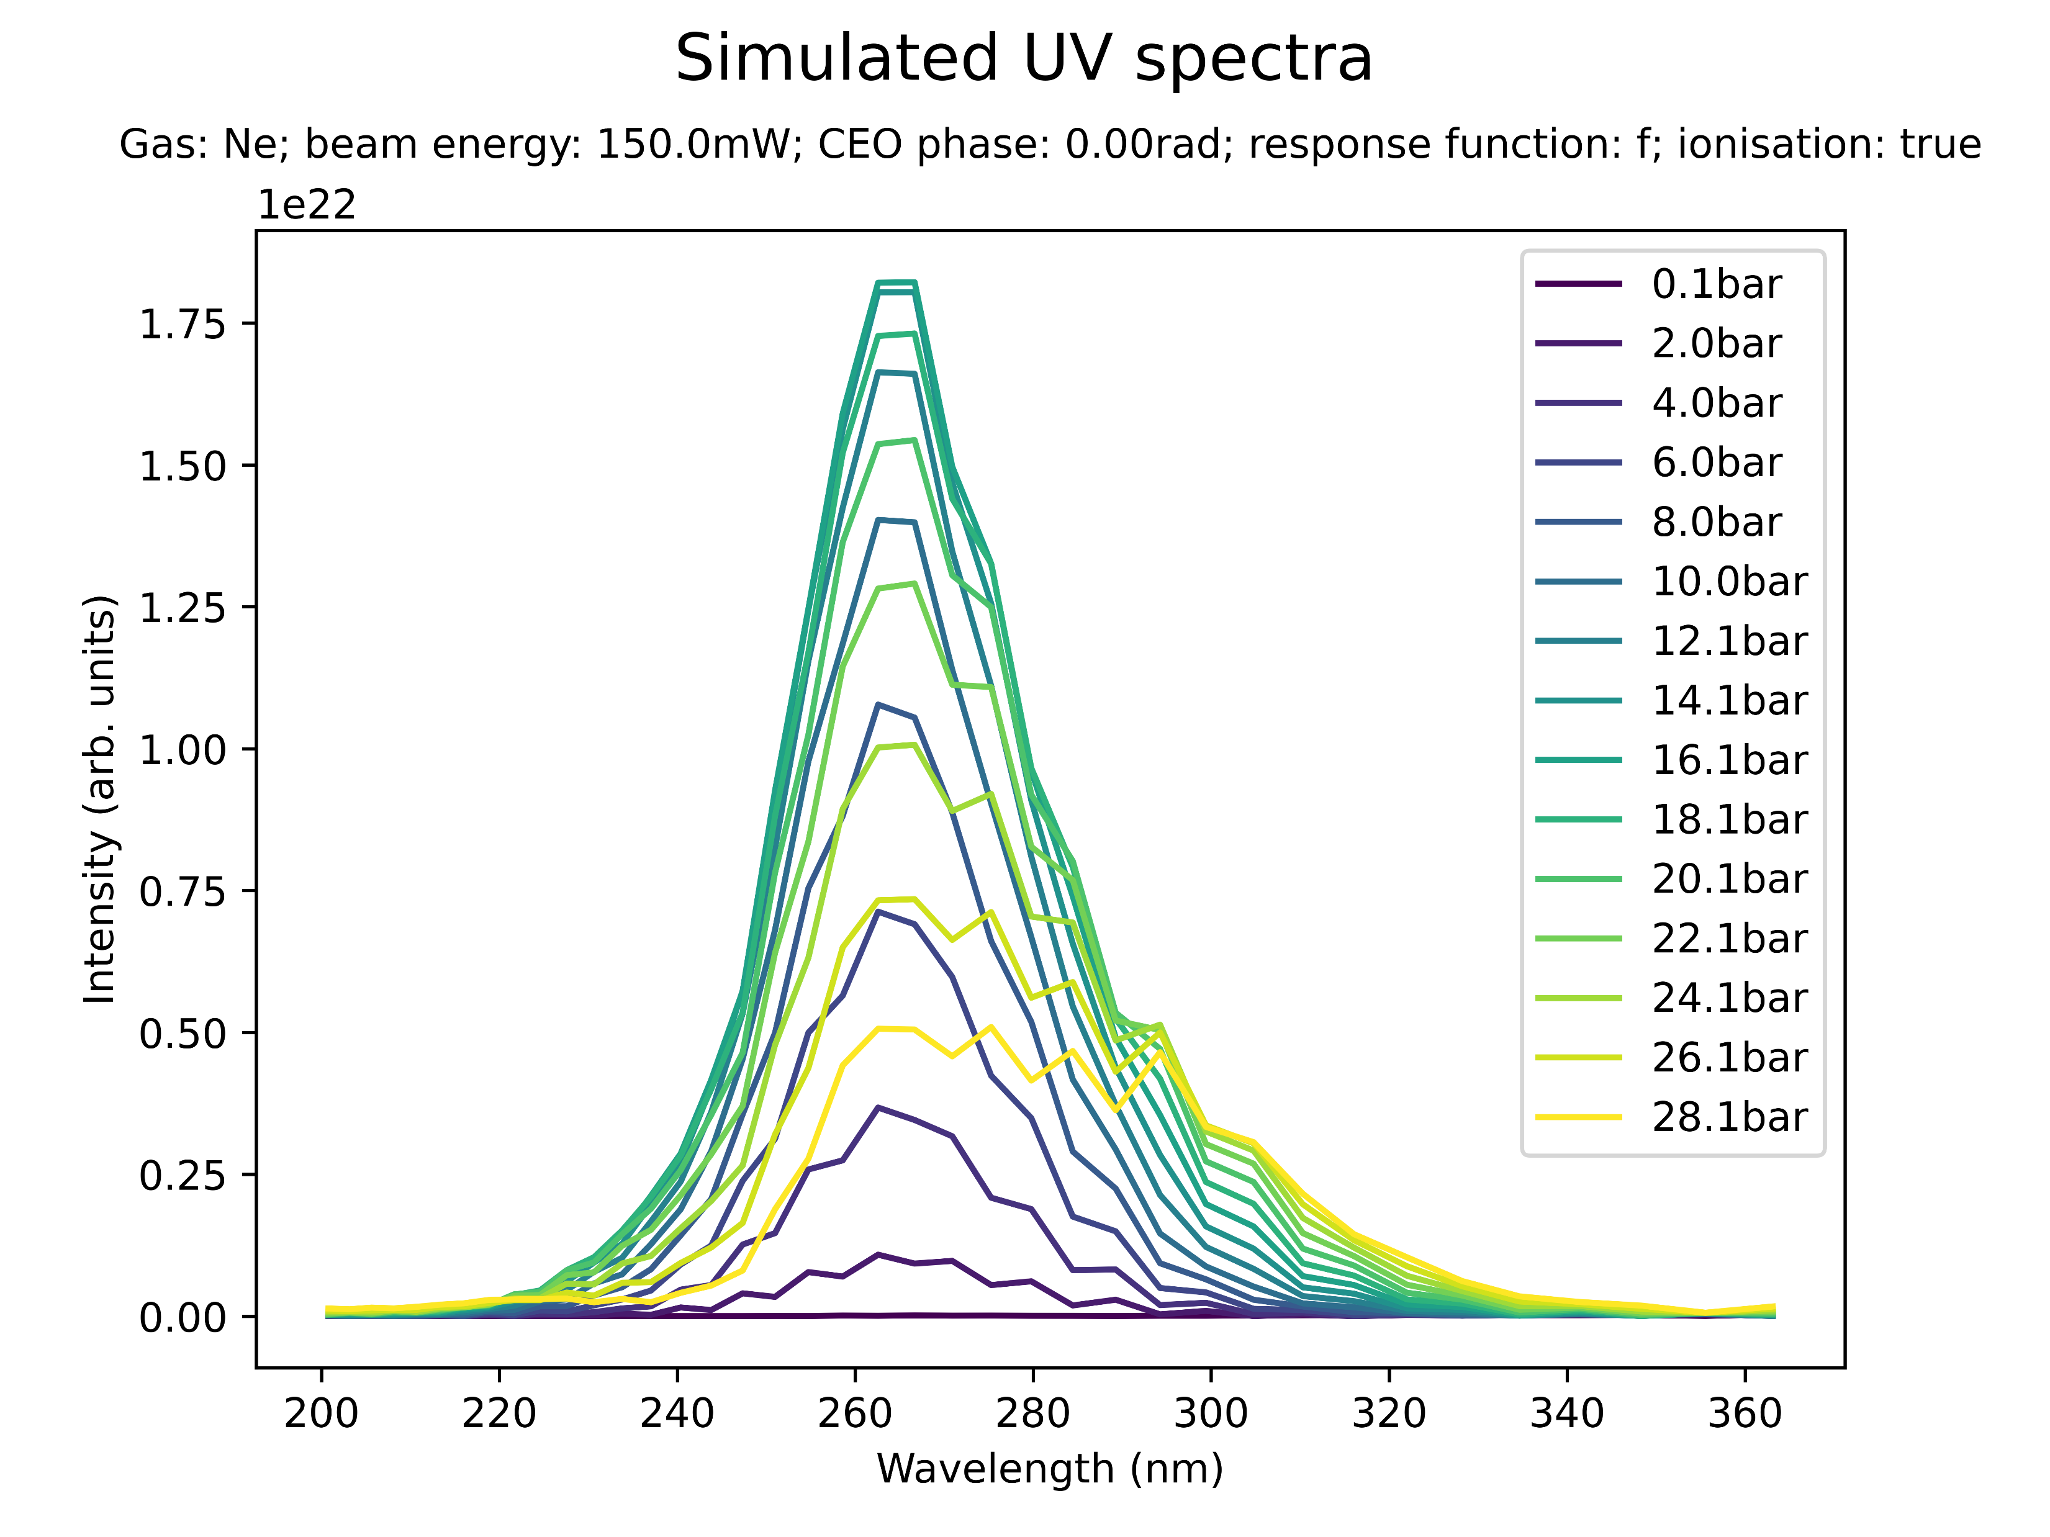
Effect of beam power on spectral peaks
Low power (Ne)

Slide 23
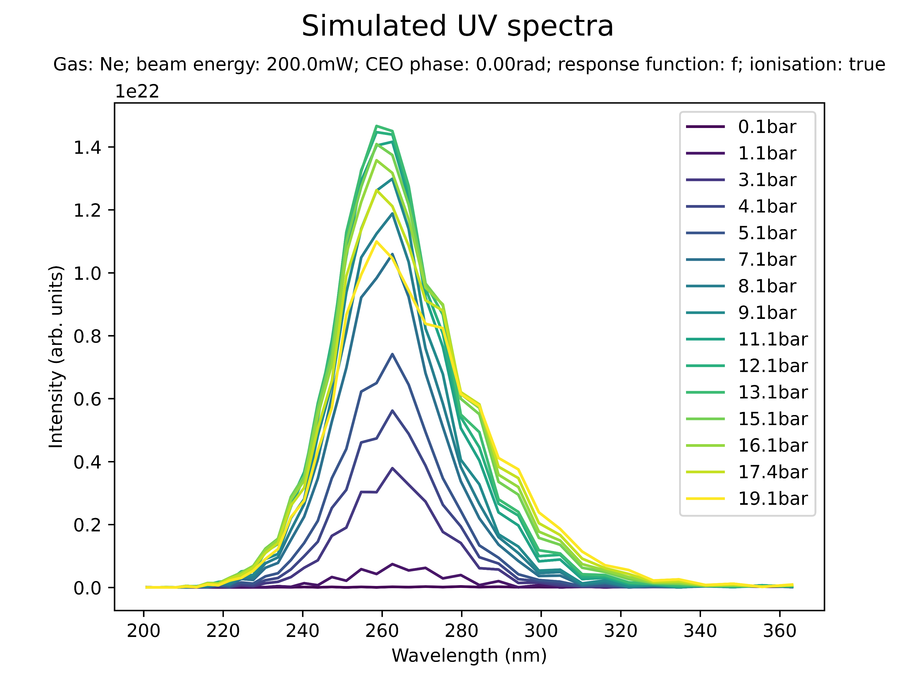
Effect of beam power on spectral peaks
Medium power (Ne)

Slide 24
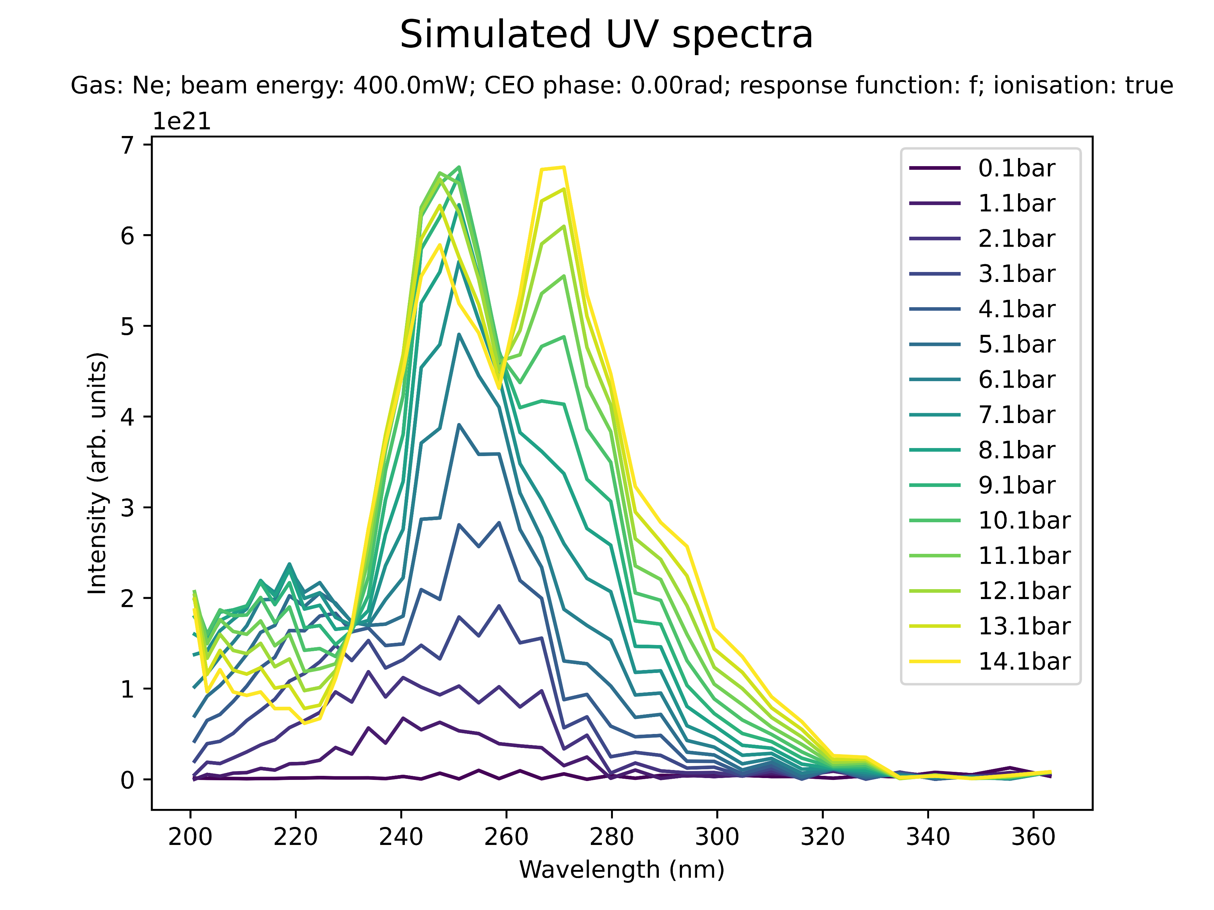
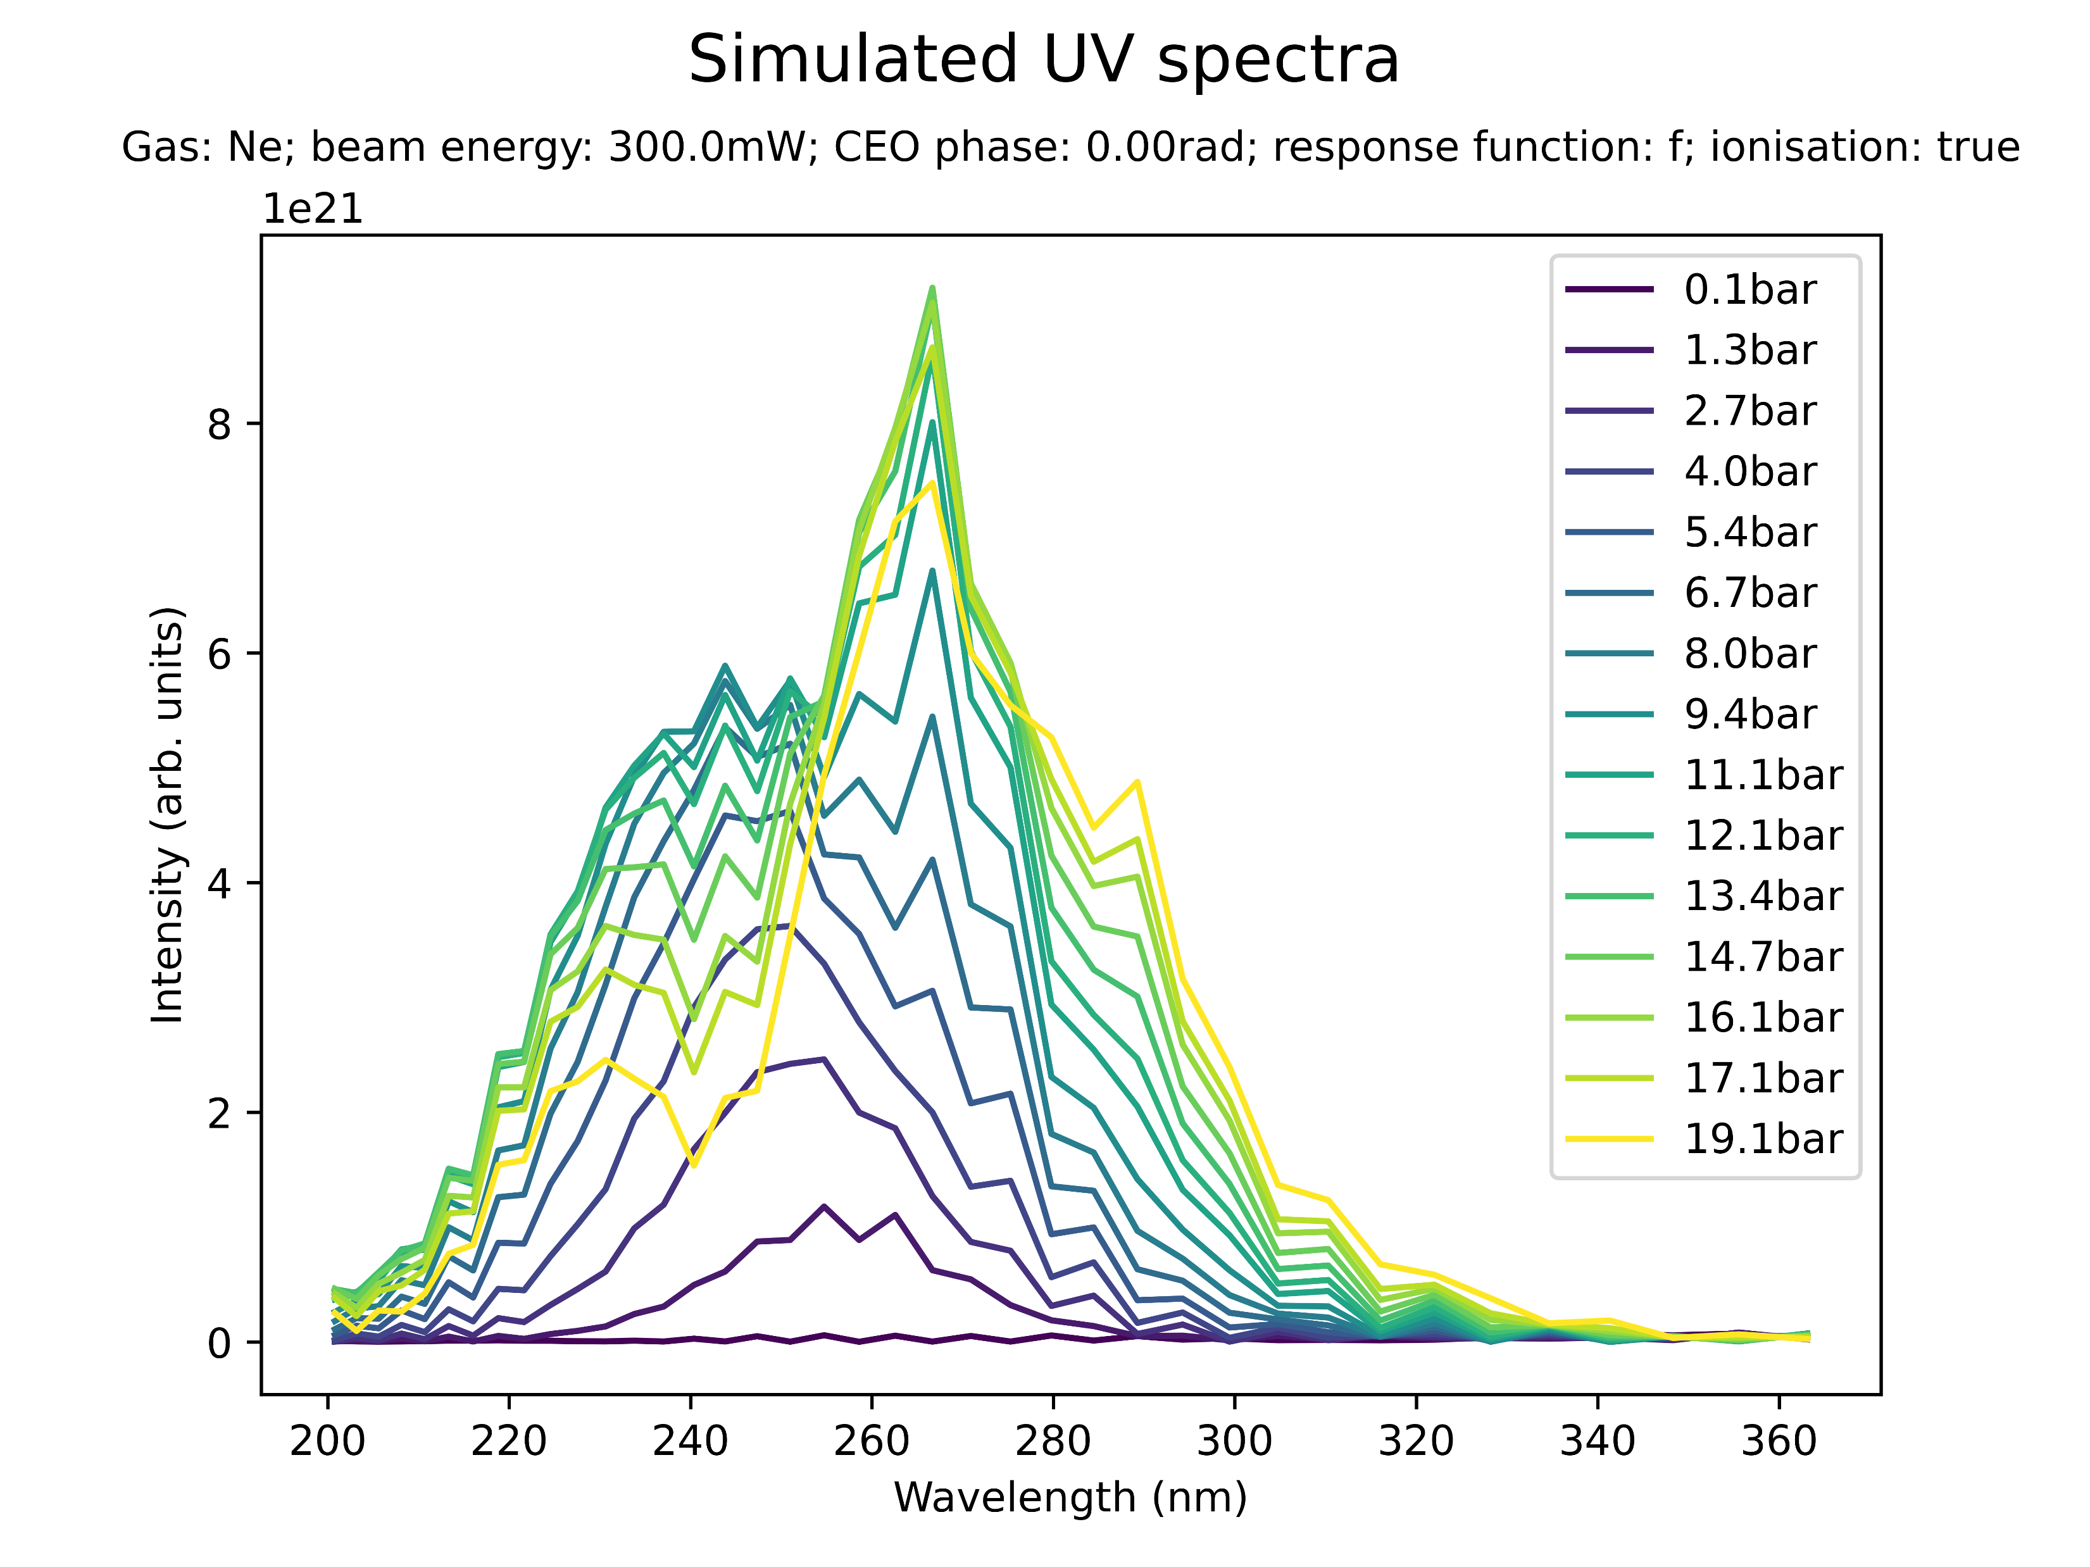
Effect of beam power on spectral peaks
High power (Ne)

Slide 25
Effect of beam power on spectral peaks
WRITE SUMMARY OF KEY INSIGHTS!!!
Note: Neon not run for high enough pressures maybe…

Slide 26
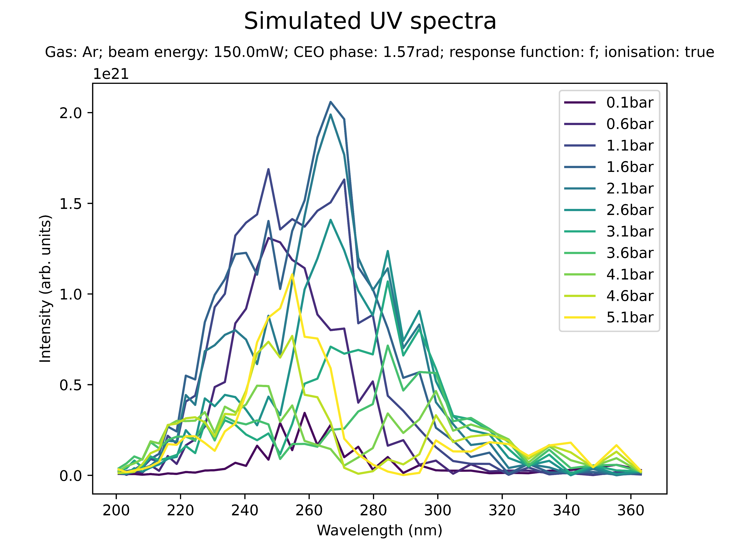
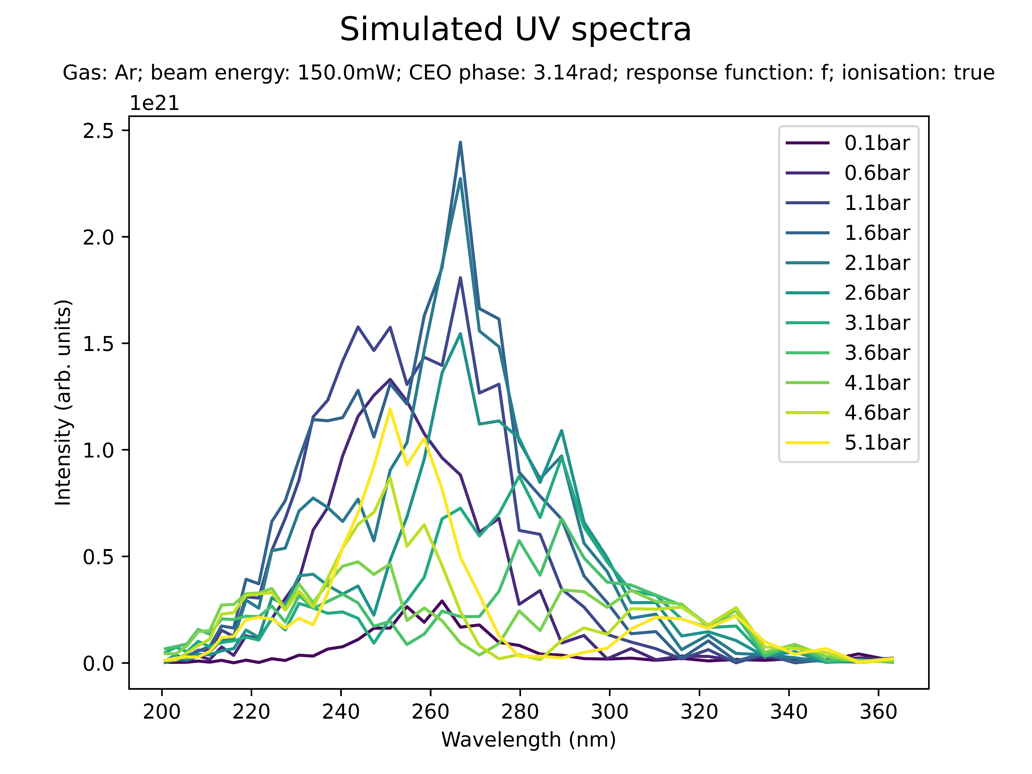
Effect of CEO phase on spectral peaks

Slide 27
Effect of CEO phase on spectral peaks
There does seem to be some effect of the CEO phase on the spectral profile
Peaks appear/disappear…
Investigate this further!

Slide 28
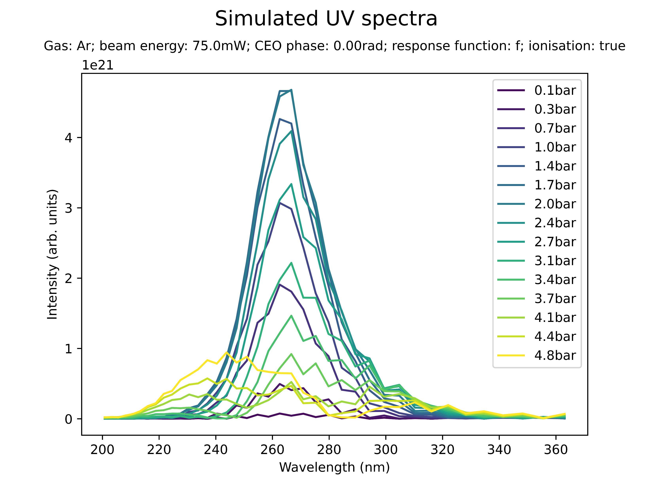
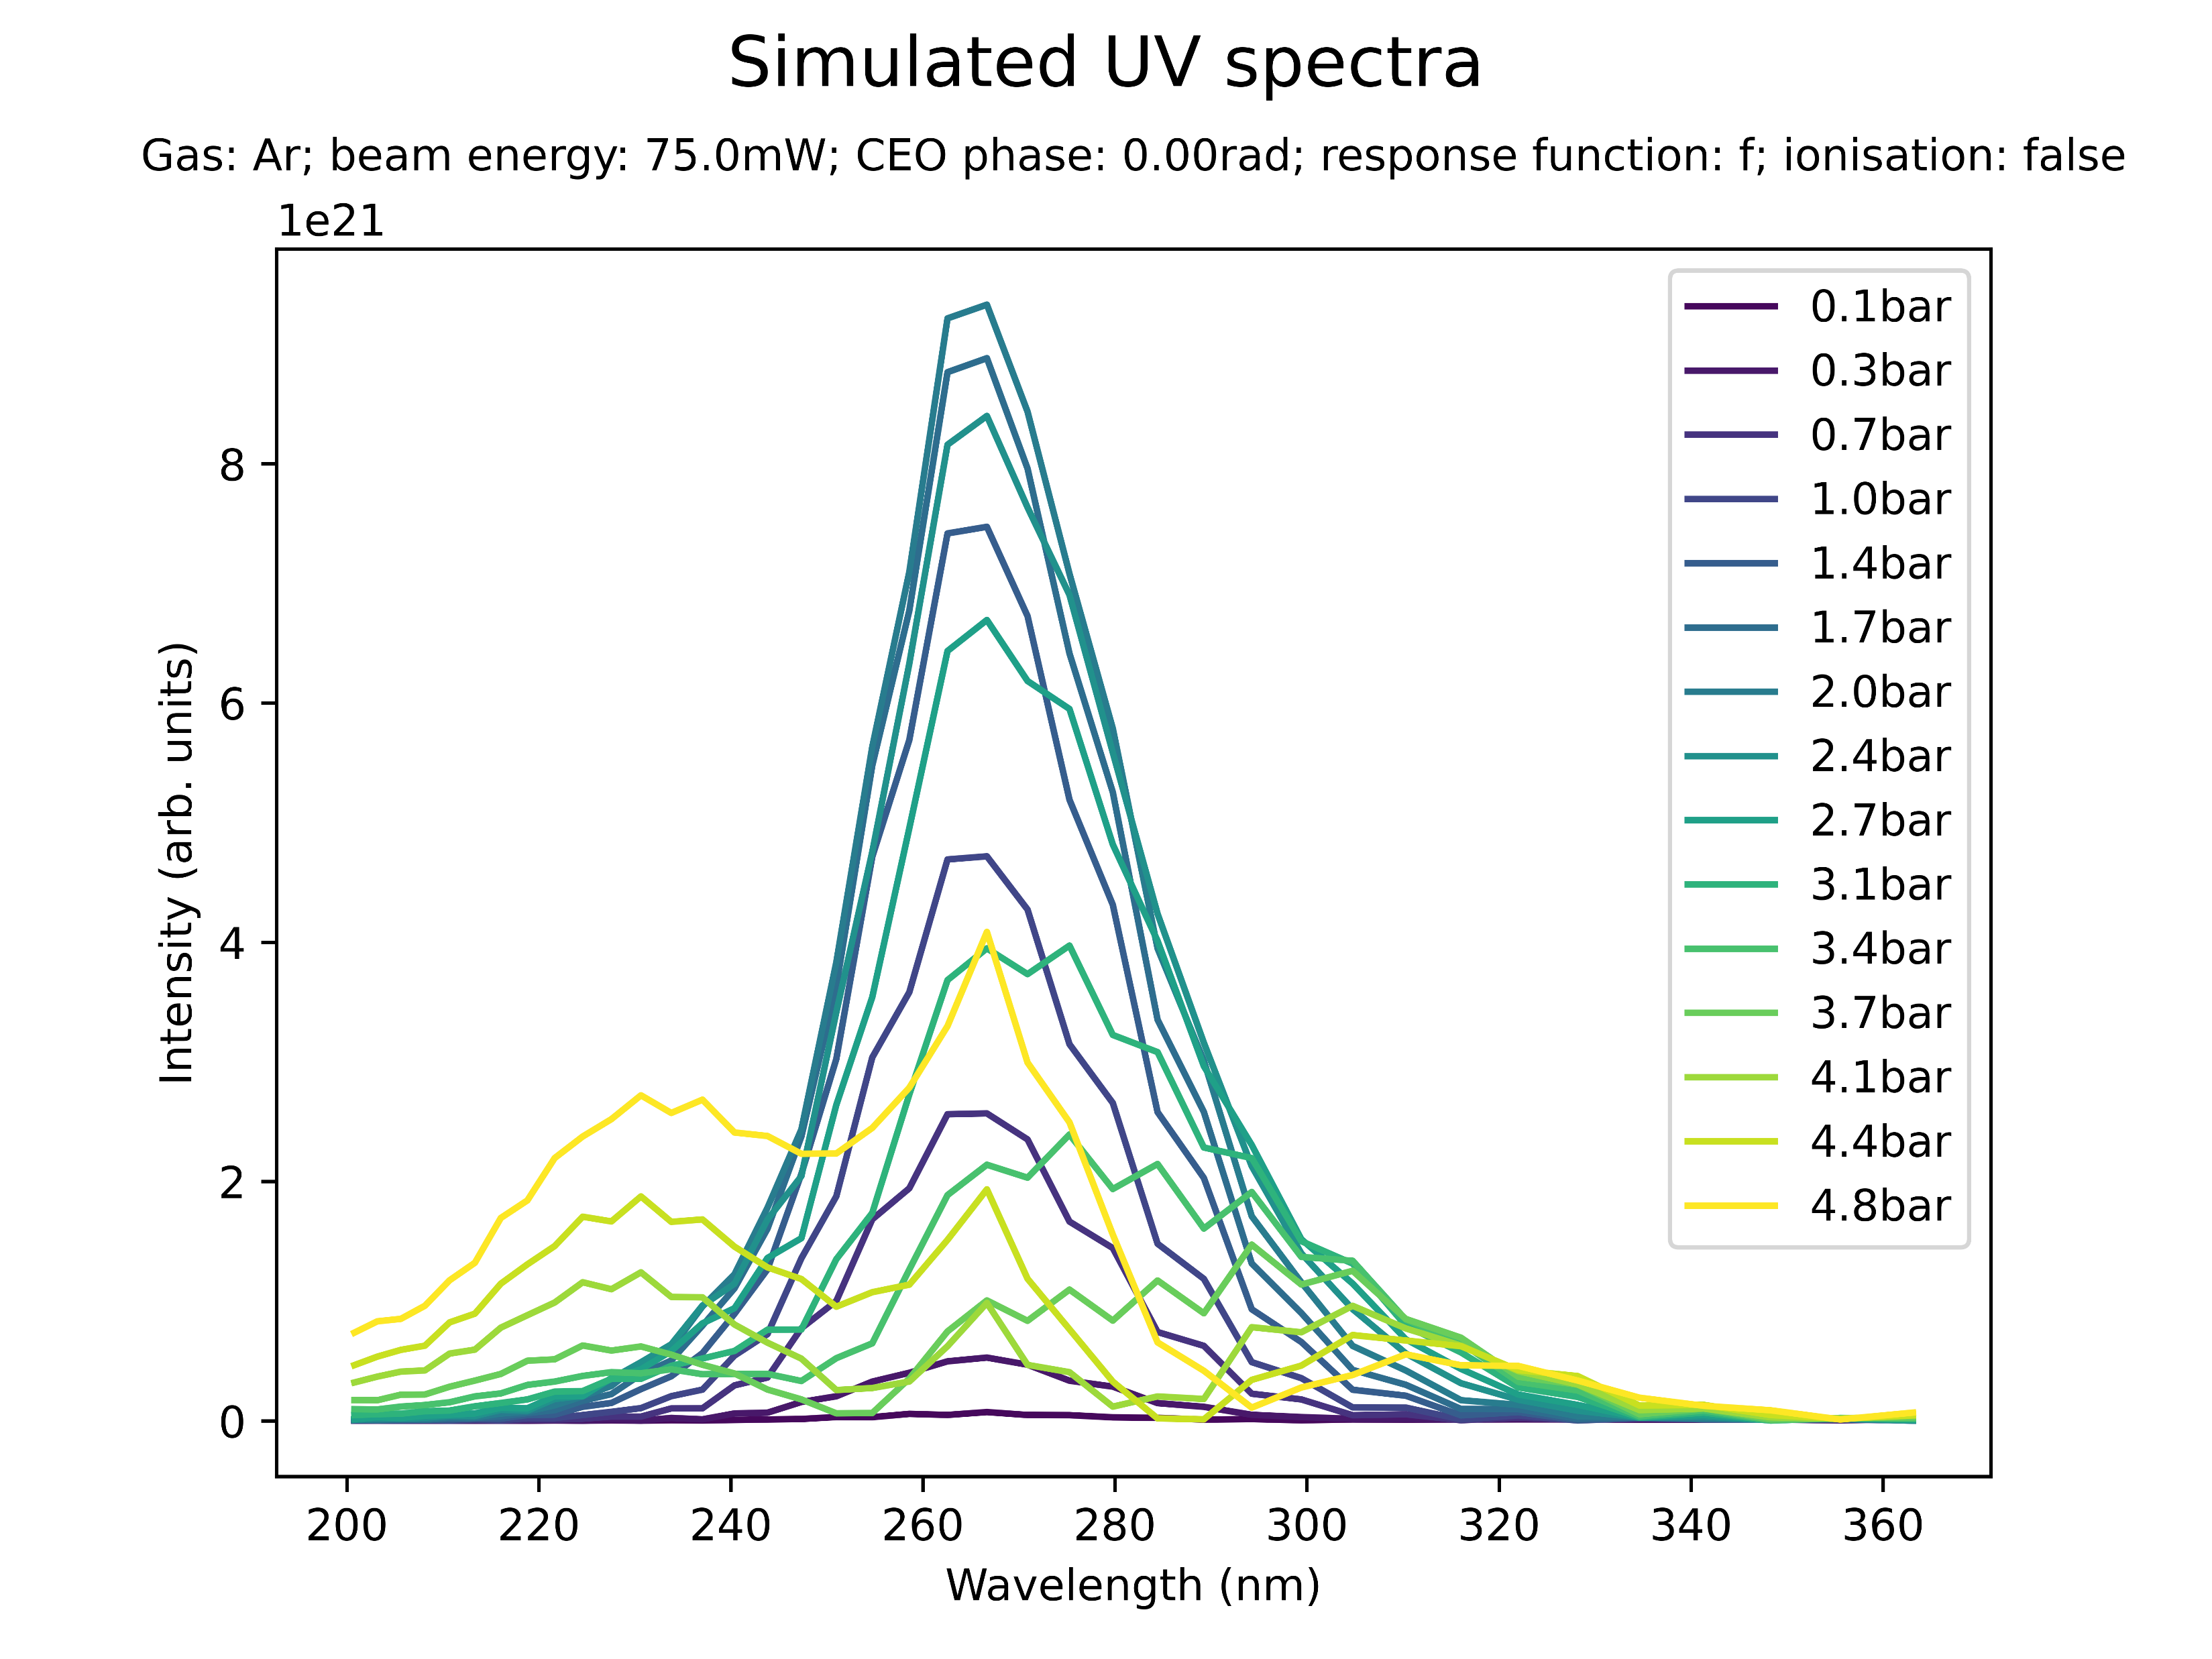
Effect of ionisation on spectral profile

Slide 29
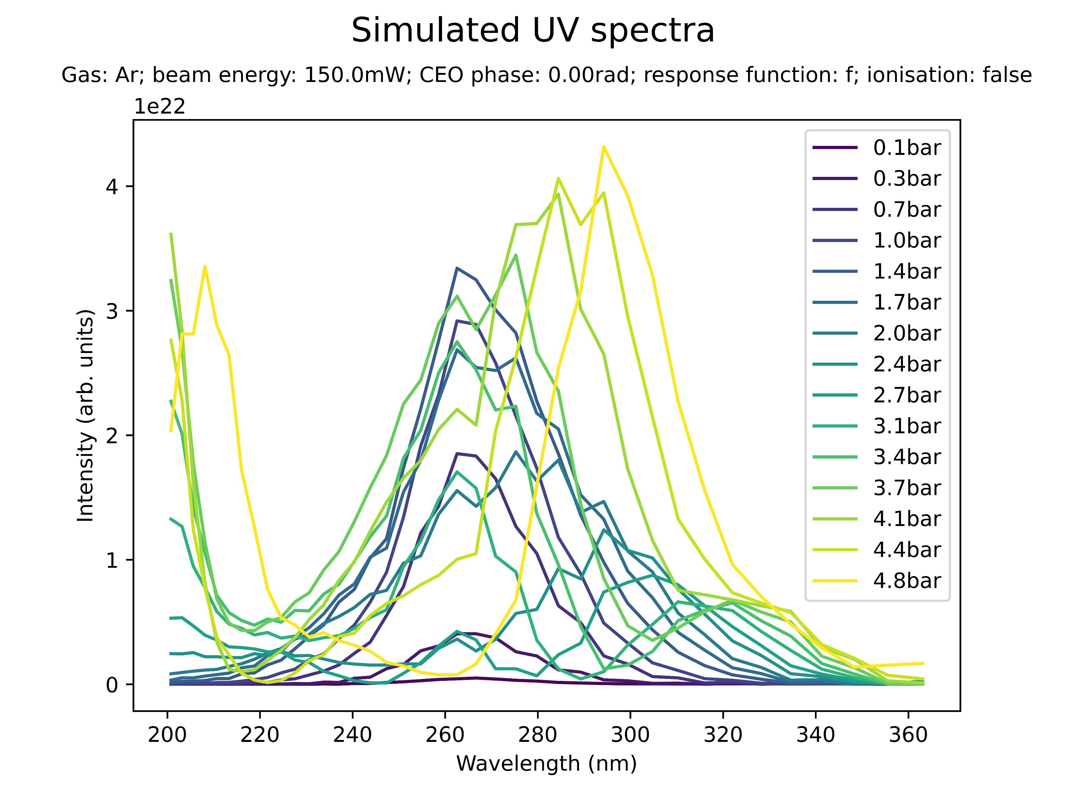
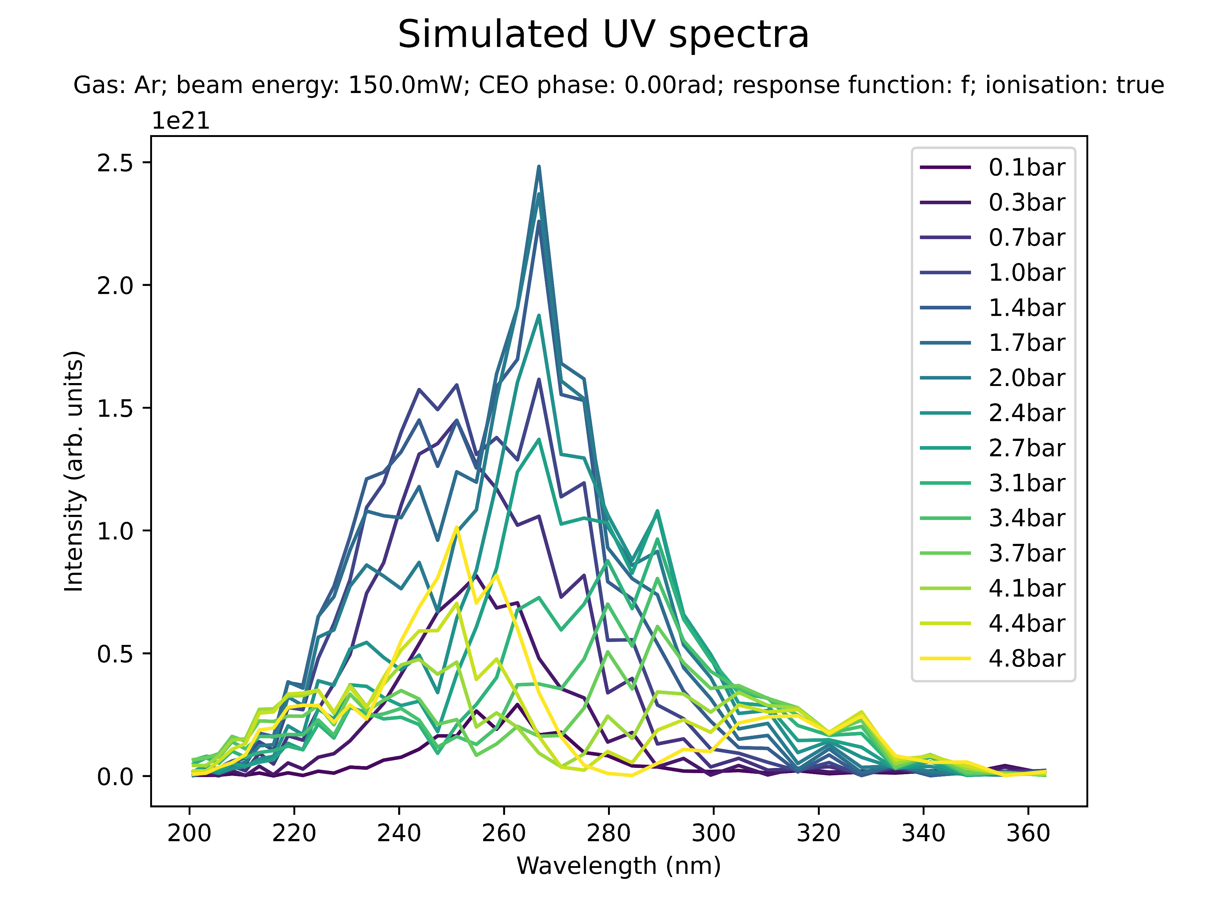
Effect of ionisation on spectral profile

Slide 30
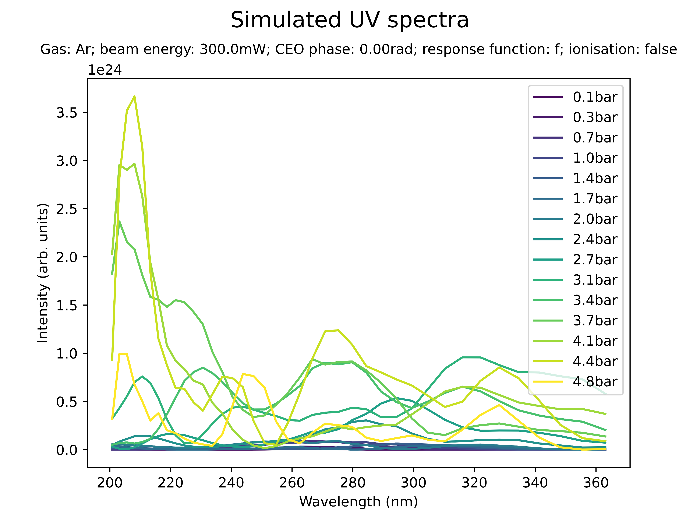

Effect of ionisation on spectral profile

Slide 31
Effect of ionisation on spectral profile
Clearly very large effect!!
Note: for Neon not run at large enough pressures to cause spectral “breaking”

Slide 32
Summary: spectral profile
When does second spectral peak appear? (relative to saturation pressure?)
Compare ionisation! Compare beam power? Compare CEO phase?!
Ionisation seems to make a difference!!
Spectrum Ar vs Ne!! -> different behaviour ?!

Slide 33
III. BEAM SHAPE

Slide 34
IV. SELF-STEEPENING

Slide 35
Conclusion & Next Steps

